Slide 1


Dr. Loyd Bastin
Associate Dean and Professor
Widener University

Slide 2
Green Chemistry at Widener University
Loyd Bastin
Distinguished University Professor of Chemistry & Biochemistry
Associate Dean of Science

Slide 3
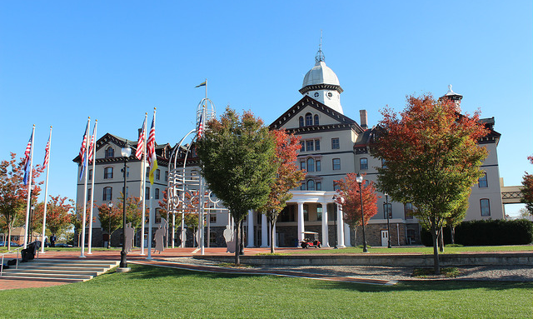
Widener University
Private, primarily undergraduate institution (professional graduate programs)
~3000 undergraduates
17 miles from Center City Philadelphia in Chester, PA
Small Classes
Connect curricula to social issues through experiential learning
Strong emphasis on general education
Amazing sustainability programs across campus
  Environmental Science & Sustainability major & minor
  Environmental Health & Sustainability Management minor
  Sustainability Science minor
  Sustainability Management minr

Slide 4
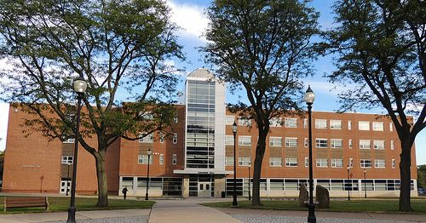

Green Chemistry at Widener University
Chemistry is an undergraduate only department
Green Organic Chemistry labs since 2007
Green Chemistry infused throughout chemistry curriculum
Joined Green Chemistry Commitment in 2014
Green Chemistry is part of our mission statement and departmental goals
BS in Green Chemistry
Beyond Benign provides educators with the tools, training and support to make green chemistry an integral part of chemistry education
  Green Chemistry Commitment
  Created 10 years ago by Beyond Benign
  Green Chemistry Commitment is a framework to unite the green chemistry higher education community around a common vision
  https://www.beyondbenign.org

Slide 5
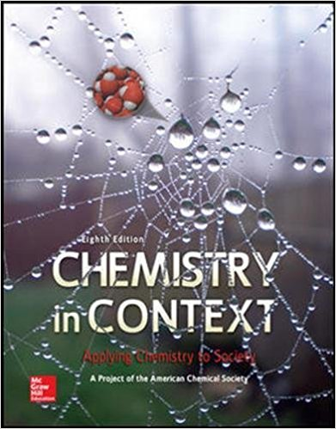
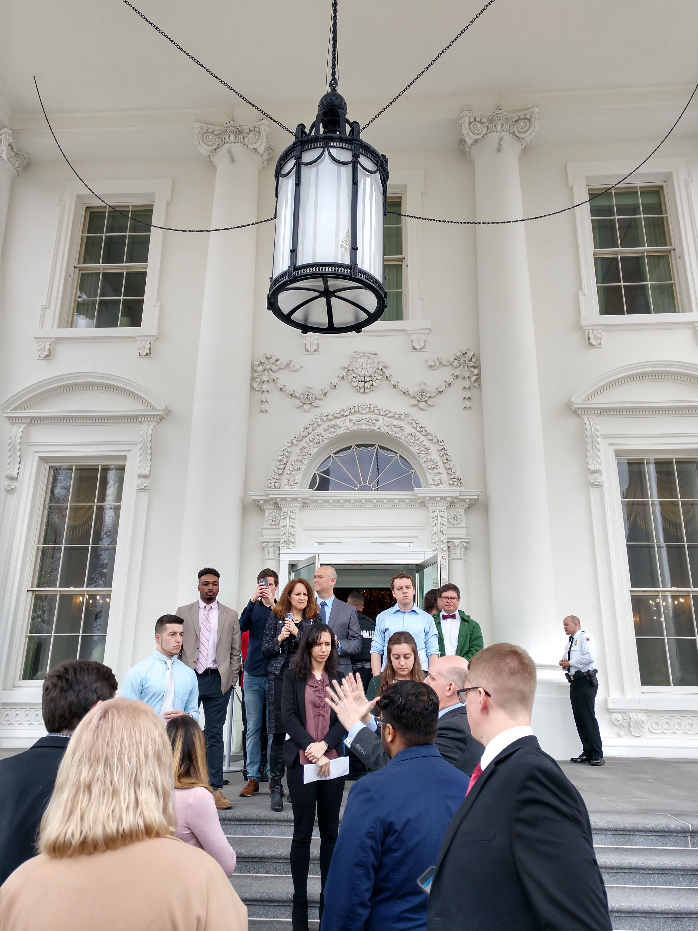

Sustainable Chemistry
Teach basic Chemical concepts using Sustainability themes
  Air, ozone, global warming, energy, water
Audience
  General Education course
  Sustainability Science minor in A&S
  Sustainability Management minors in SBA
  BA in Env. Health & Sust. Management
Civic Engagement
  Collaboration with Dr. Corbo and Dr. Leckrone
  White House or Capitol Visit
  ACS-GCI visit
  Environmental Justice Tour of Chester
  Special Guests to discuss Environmental Issues
  in Chester
  Lobby Day in Harrisburg
  L.D. Bastin, A. Martin, “Promoting Political and Civic Engagement in a Non-Majors Sustainable Chemistry Course.” In Integrating Green and Sustainable Chemistry Principles into Education; A.P. Dicks, L.D. Bastin, Eds.; Elsevier, 2019, 141-162.

Slide 6
General Chemistry
Lecture
  Customized open source LibreText
  Incorporates Green Chemistry stories and examples throughout lecture using energy use and reaction efficiency
  Students judge reaction efficiency using atom economy and percent yield
Laboratory
  12 principles of Green Chemistry introduced through safety
  Discuss reaction efficiency using atom economy and percent yield
  Consider reaction scale to minimize reagents and waste
  Research hazards and precautions for chemicals used

Slide 7
Organic Chemistry Laboratory
Introduction to Environmental Contamination & Chemical Exposure
Introduction to Green Chemistry
Application of Green Chemistry
  Analyze greenness of current experiments
  Percent Yield, PMI, RMI
  Revise/design experiments
Use of Microwave reactor
Green research-based syntheses in Organic II lab
  PLA synthesis
  Fischer Esterification
  3-step maleimide synthesis
Research students helped find & design experiments
Research students performed & modified literature procedures
Organic students performed experiments
Organic students suggested modifications
Research students tested faculty & student modifications
Bastin, L.D.; Gerhart, K. In Green Chemistry Experiments in Undergraduate Laboratories; Fahey, J.T., Maelia, L.E., Eds.; Vol. ACS Symposium Series 1233; American Chemical Society: 2016; pp 55-69.
L.D. Bastin, M. Nigam, S. Martinus, J.E. Maloney, L.L. Benyack, B. Gainer, Green Chemistry Lett. Reviews 2019, 12, 127-135.

Slide 8
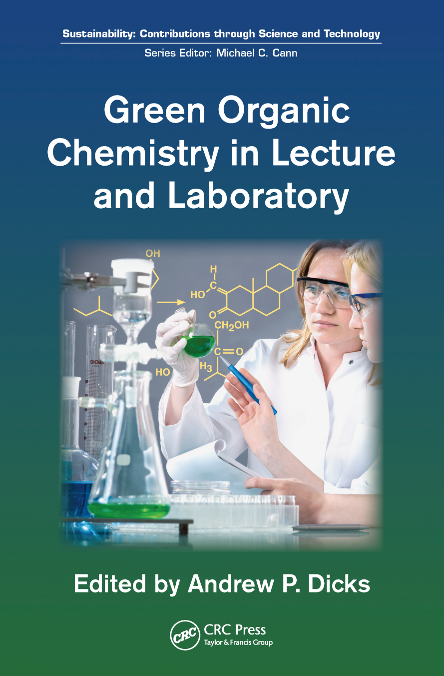
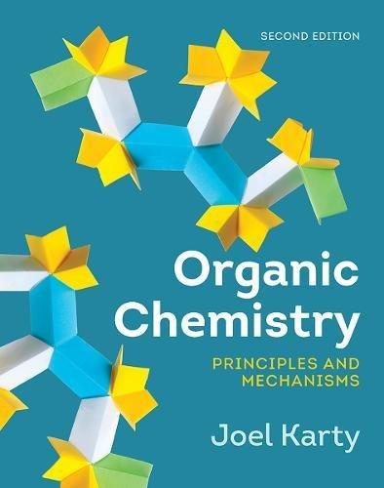
Organic Chemistry Lecture
Bromination (lab & lecture)
Elimination (lab & lecture)
Williamson-Ether Synthesis (lab & lecture)
Oxidation
Reduction (lab & lecture)
Aldol Condensation (lab & lecture)
Wittig
Diels-Alder
Epoxidation

Slide 9

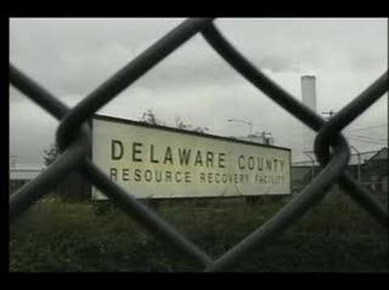
Chester’s Environmental Racism Story
“Laid to Waste”, Produced by Robert Bahar & George McCollough, Berkeley Media LLC, 1997
Several community organizations focused on improving quality of living in Chester and fighting Environmental Racism
Chester Environmental Partnership
CRCQL

Slide 10
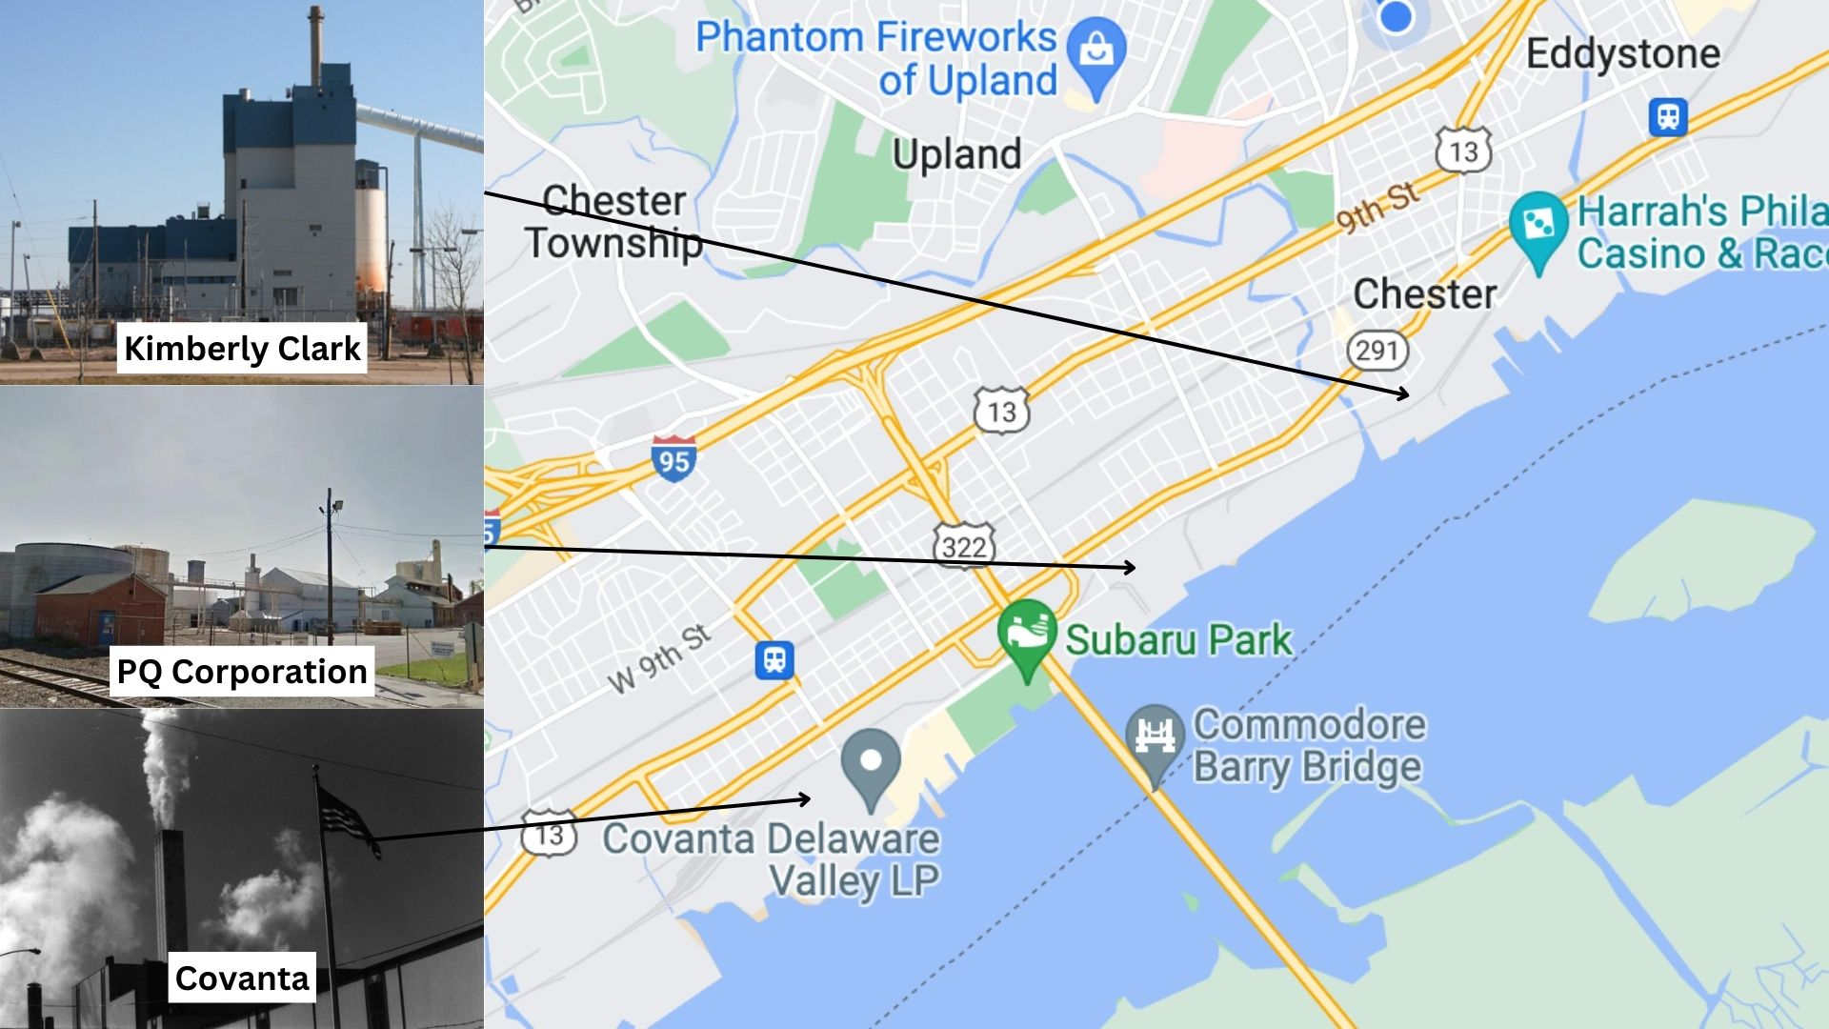
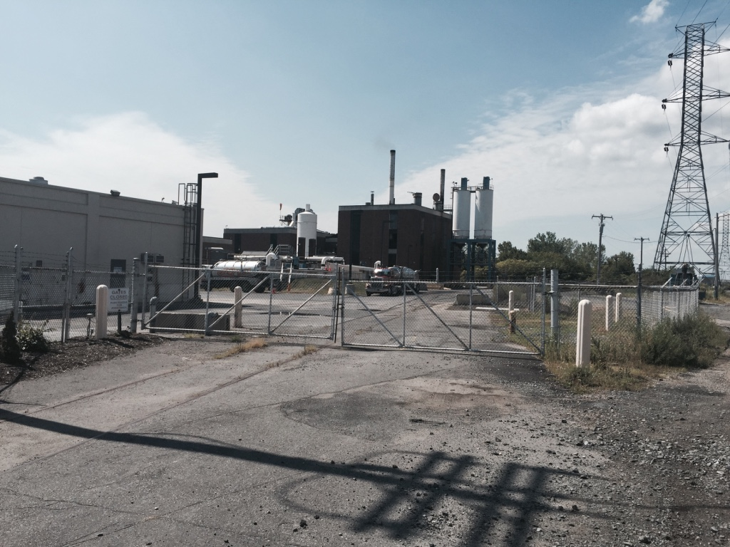
Waste/Chemical Industry in Chester
Delcora Water Treatment
Map created by Cloë DiFlumeri

Slide 11
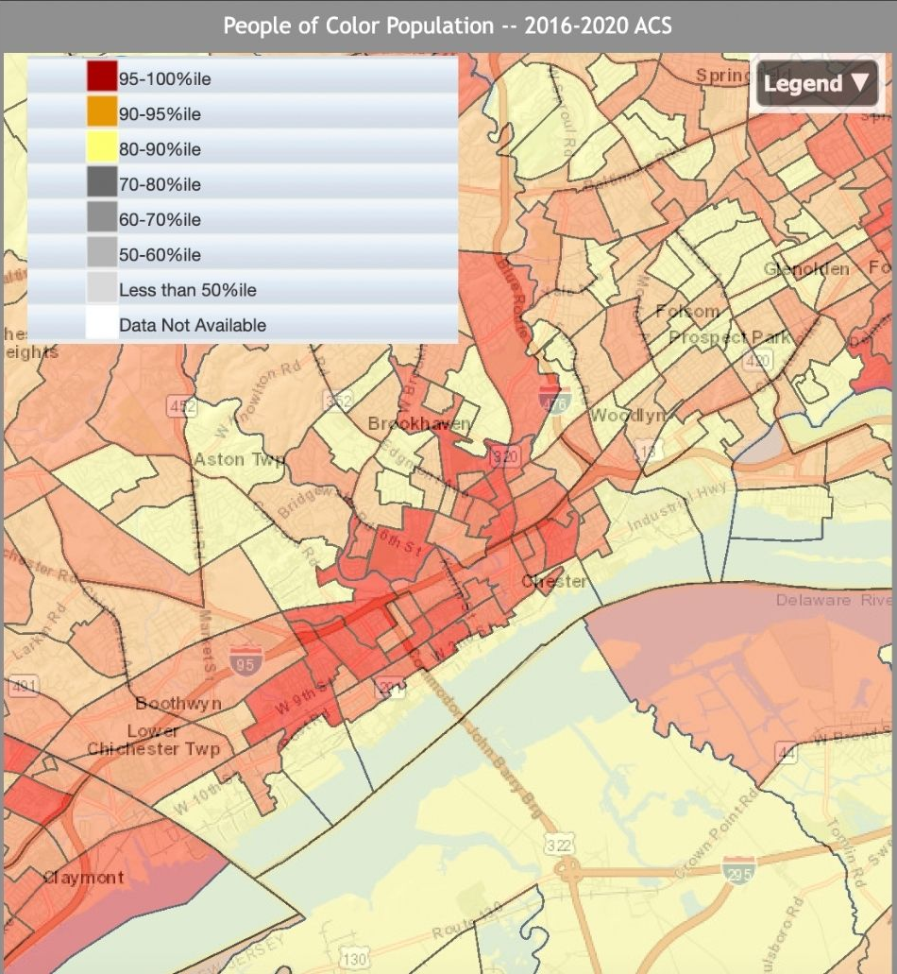
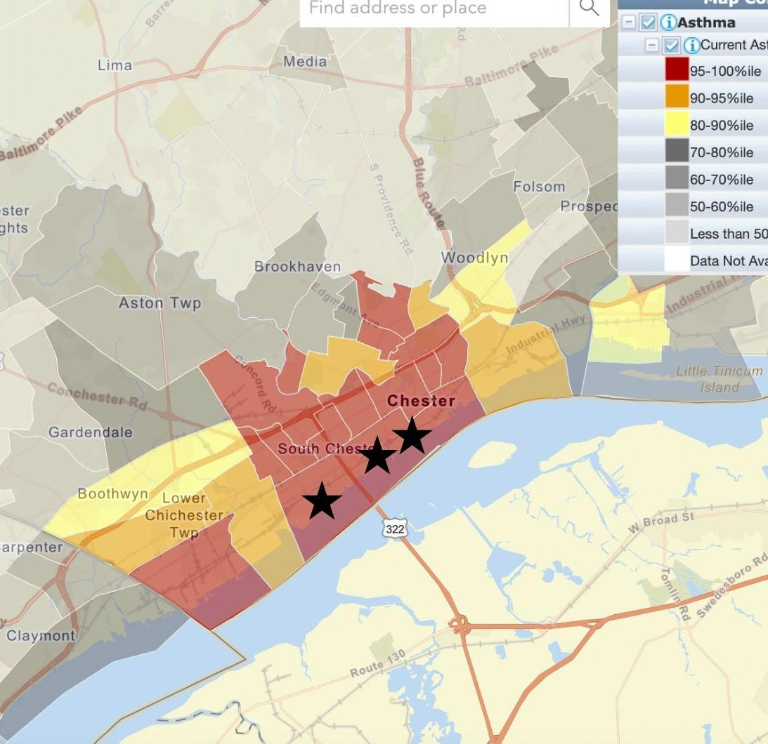
Environmental Racism in Chester
Maps created by Cloë DiFlumeri
Notes:
Introduce poc stats, Pq corp pocket

Slide 12
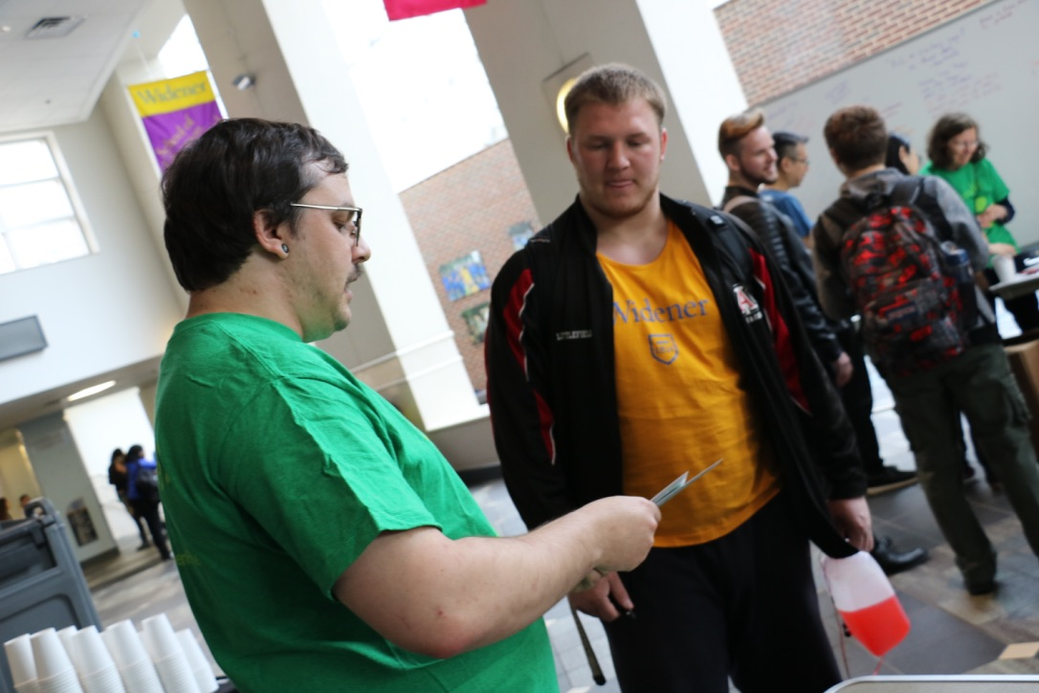
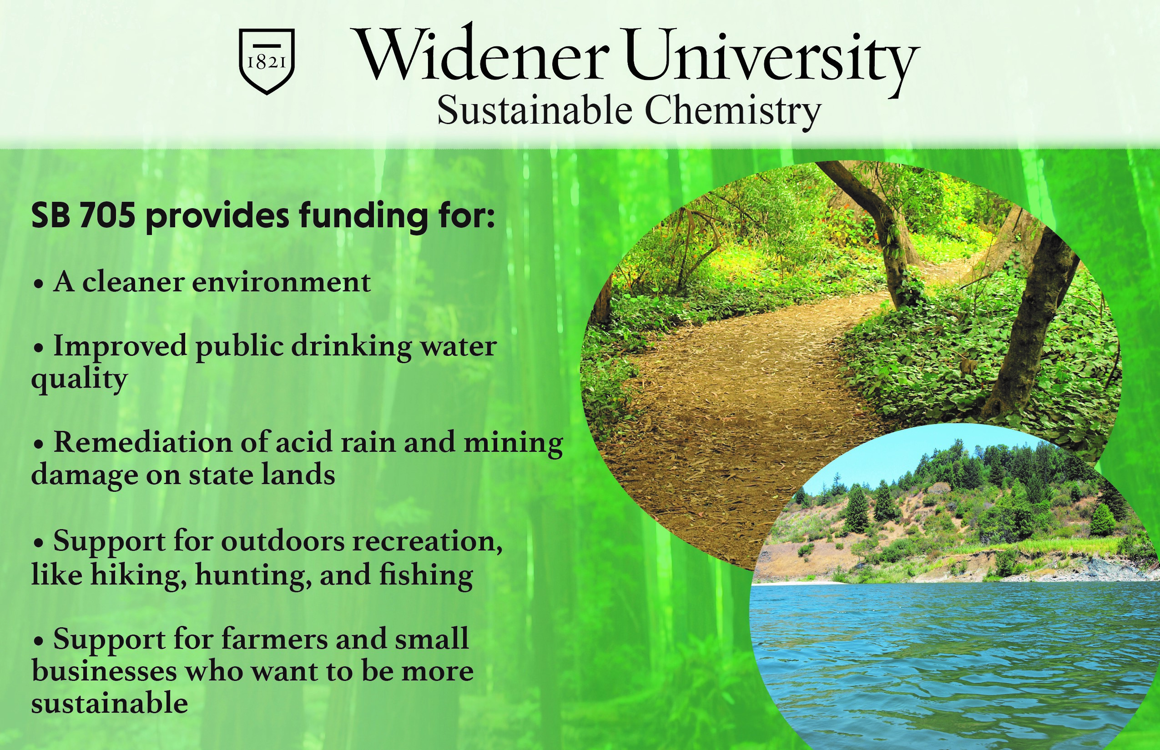
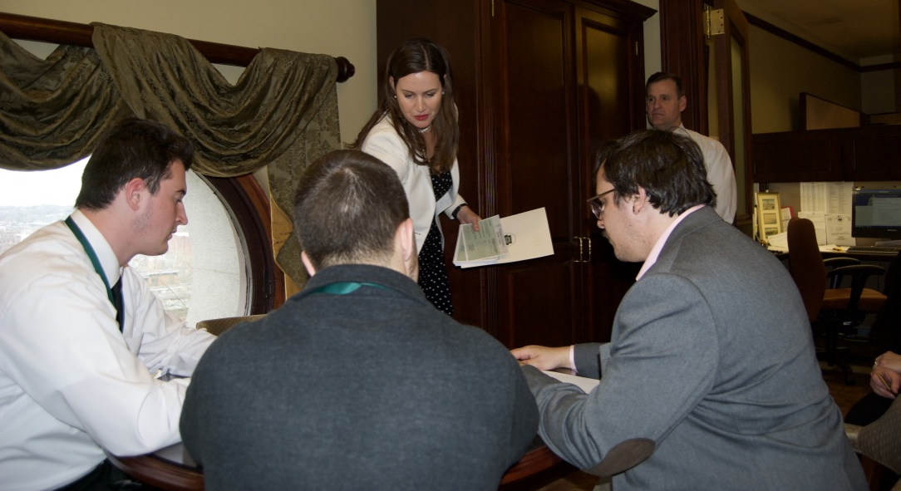
Lobby Day Project in Sustainable Chemistry
Identify pending environmental legislation
Summarize bill & discusss
Draft white paper
Create postcards summarizing class position on legislation
Meet with representatives in Harrisburg
Project Reflection
  L.D. Bastin, A. Martin, “Promoting Political and Civic Engagement in a Non-Majors Sustainable Chemistry Course.” In Integrating Green and Sustainable Chemistry Principles into Education; A.P. Dicks, L.D. Bastin, Eds.; Elsevier, 2019, 141-162.

Slide 13
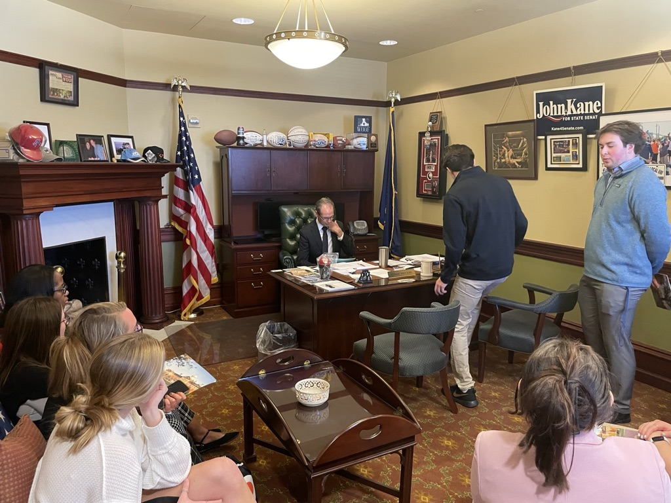
Lobby Day Project in Organic II
Change agents in the laboratory/industry
How else can scientist be change agents?
Lobby Day Project
Identify pending legislation
Summarize bill & discuss
Research key points of bill
Postcards summarizing class position on legislation
Meet with representatives in Harrisburg
Project Reflection
L.D. Bastin, “Political engagement in Organic Chemistry: An advocacy project utilizing green and sustainable chemistry.” Green Chemistry Letters and Reviews 2023, 16(1), https://doi.org/10.1080/17518253.2023.2185546

Slide 14

Upper Level Courses
  Biochemistry
    Molecular Toxicology
  Instrumental Analysis & Physical Chemistry
    Students always consider reaction scale to minimize waste
  Synthesis and Spectroscopy Course
    Green Synthesis of Pharmaceuticals
  Senior Research Experience
    Many sustainability related projects

Slide 15
Greening Process
Greener Process Research Projects
  Greener Synthesis of pharmaceuticals
    Resveratrol derivatives
    Isoxazole derivatives
    Phenylmaleimide derivatives
  Microwave synthesis of metal organic frameworks
  Microwave synthesis of platinum complexes

Slide 16
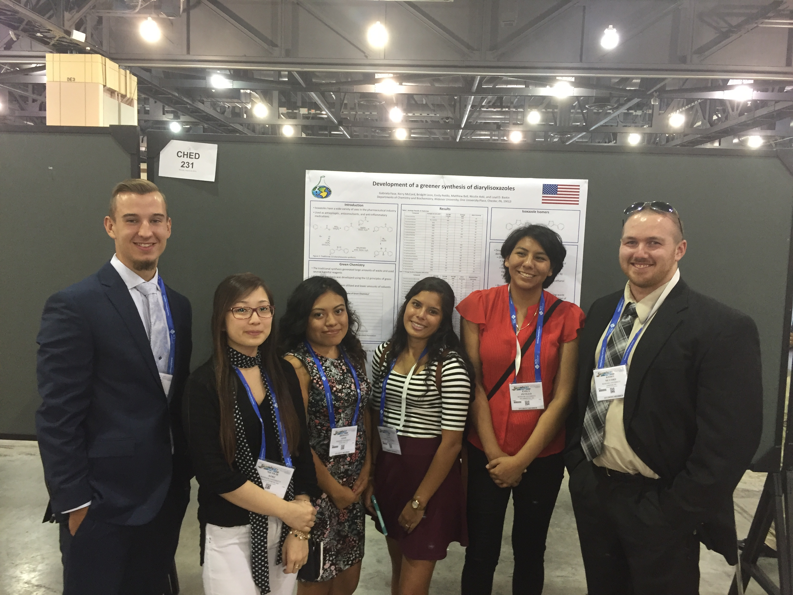
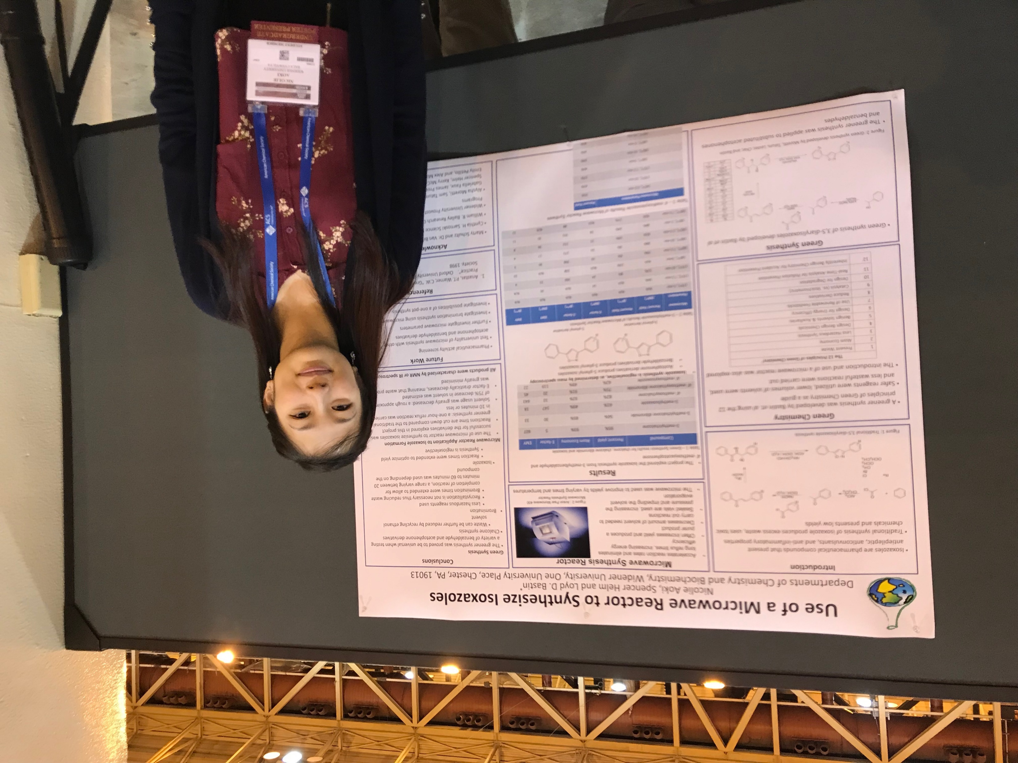

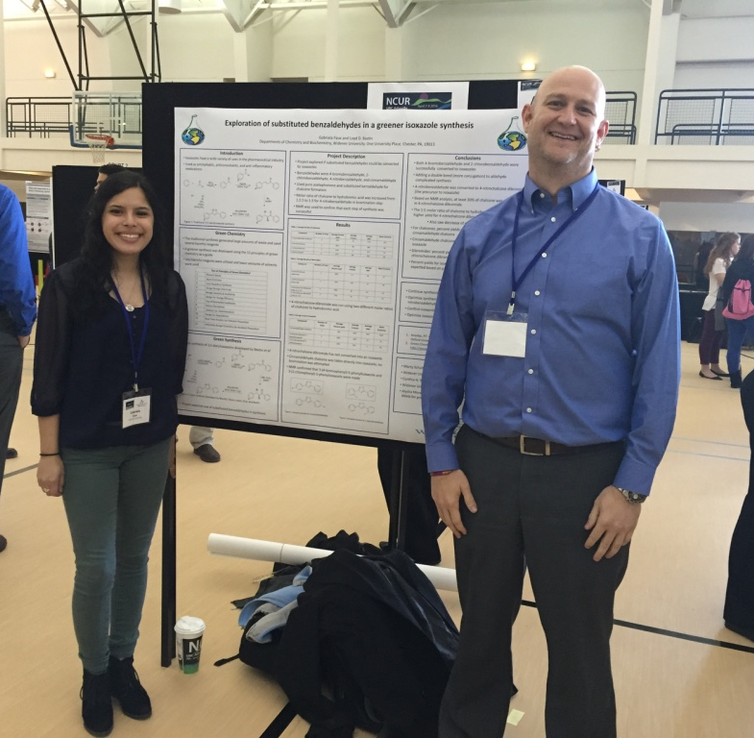
Isoxazoles (Loyd Bastin)
Bastin et al. Green Chem. Lett. Rev., in prep
Bastin et al. J. Chem. Educ., in prep

Slide 17
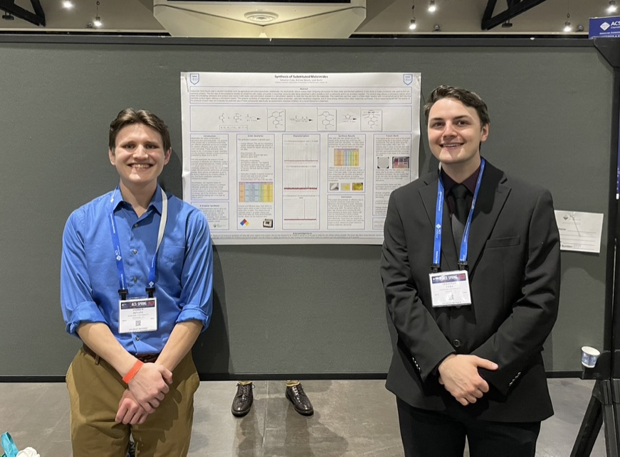
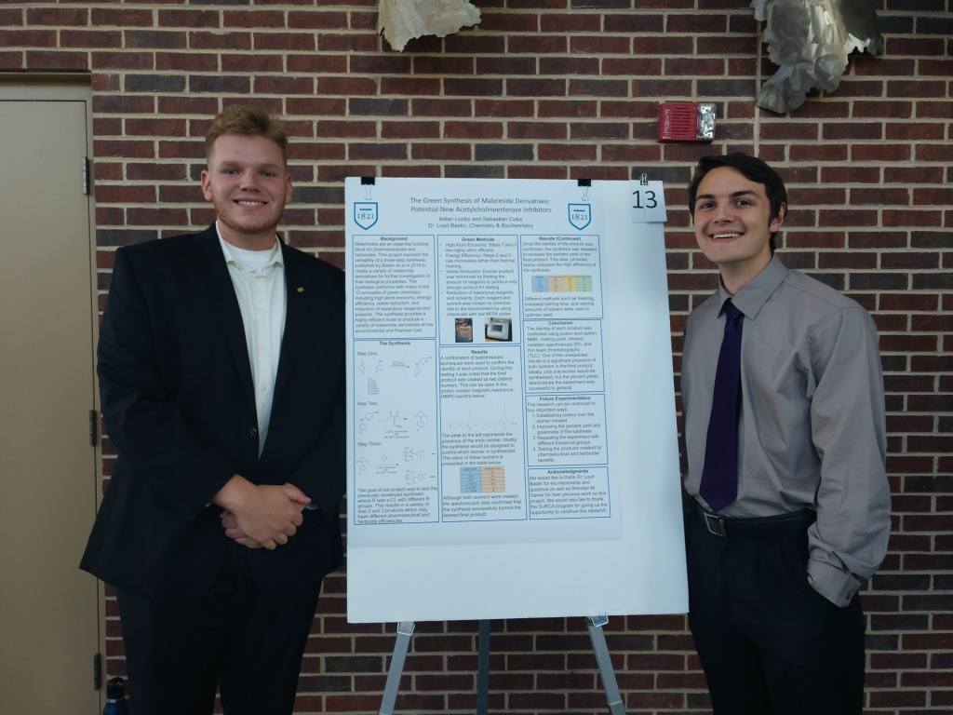
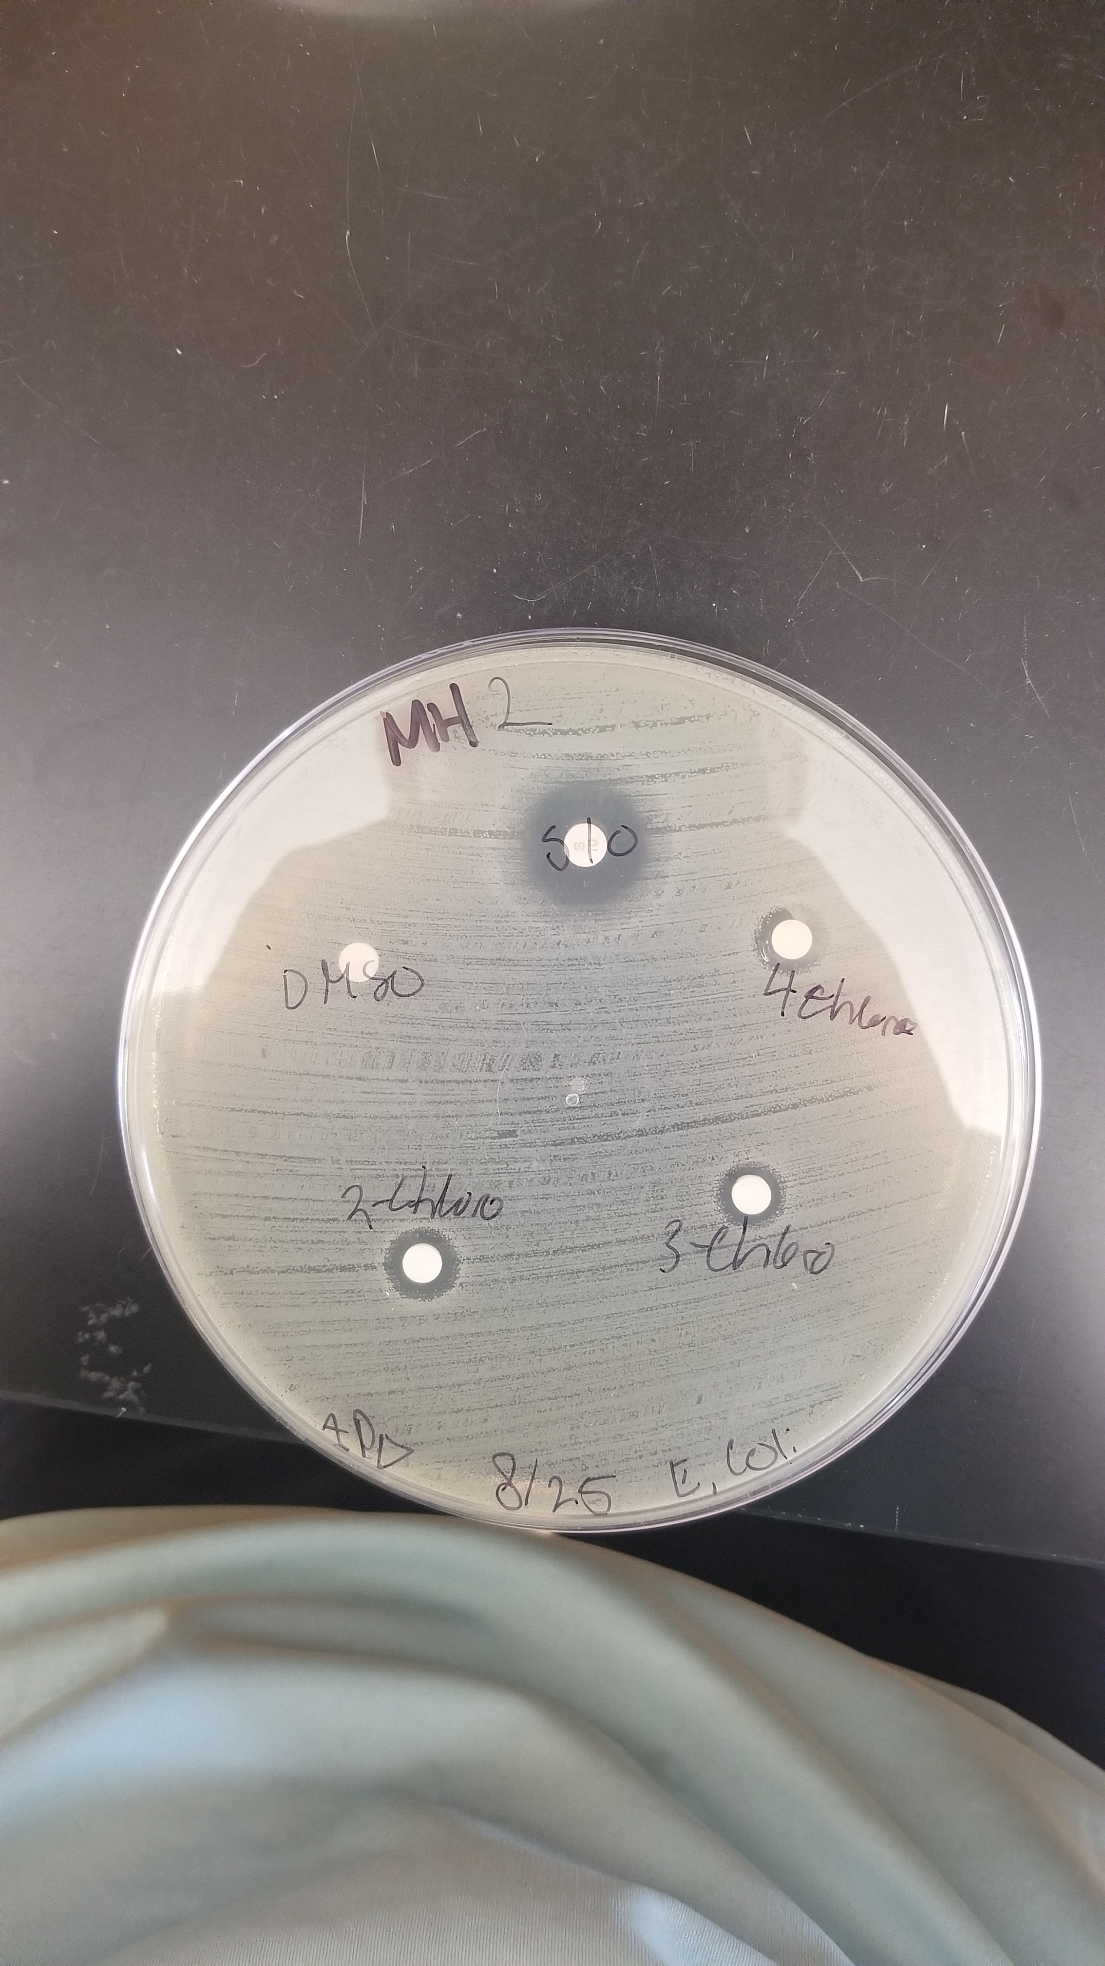
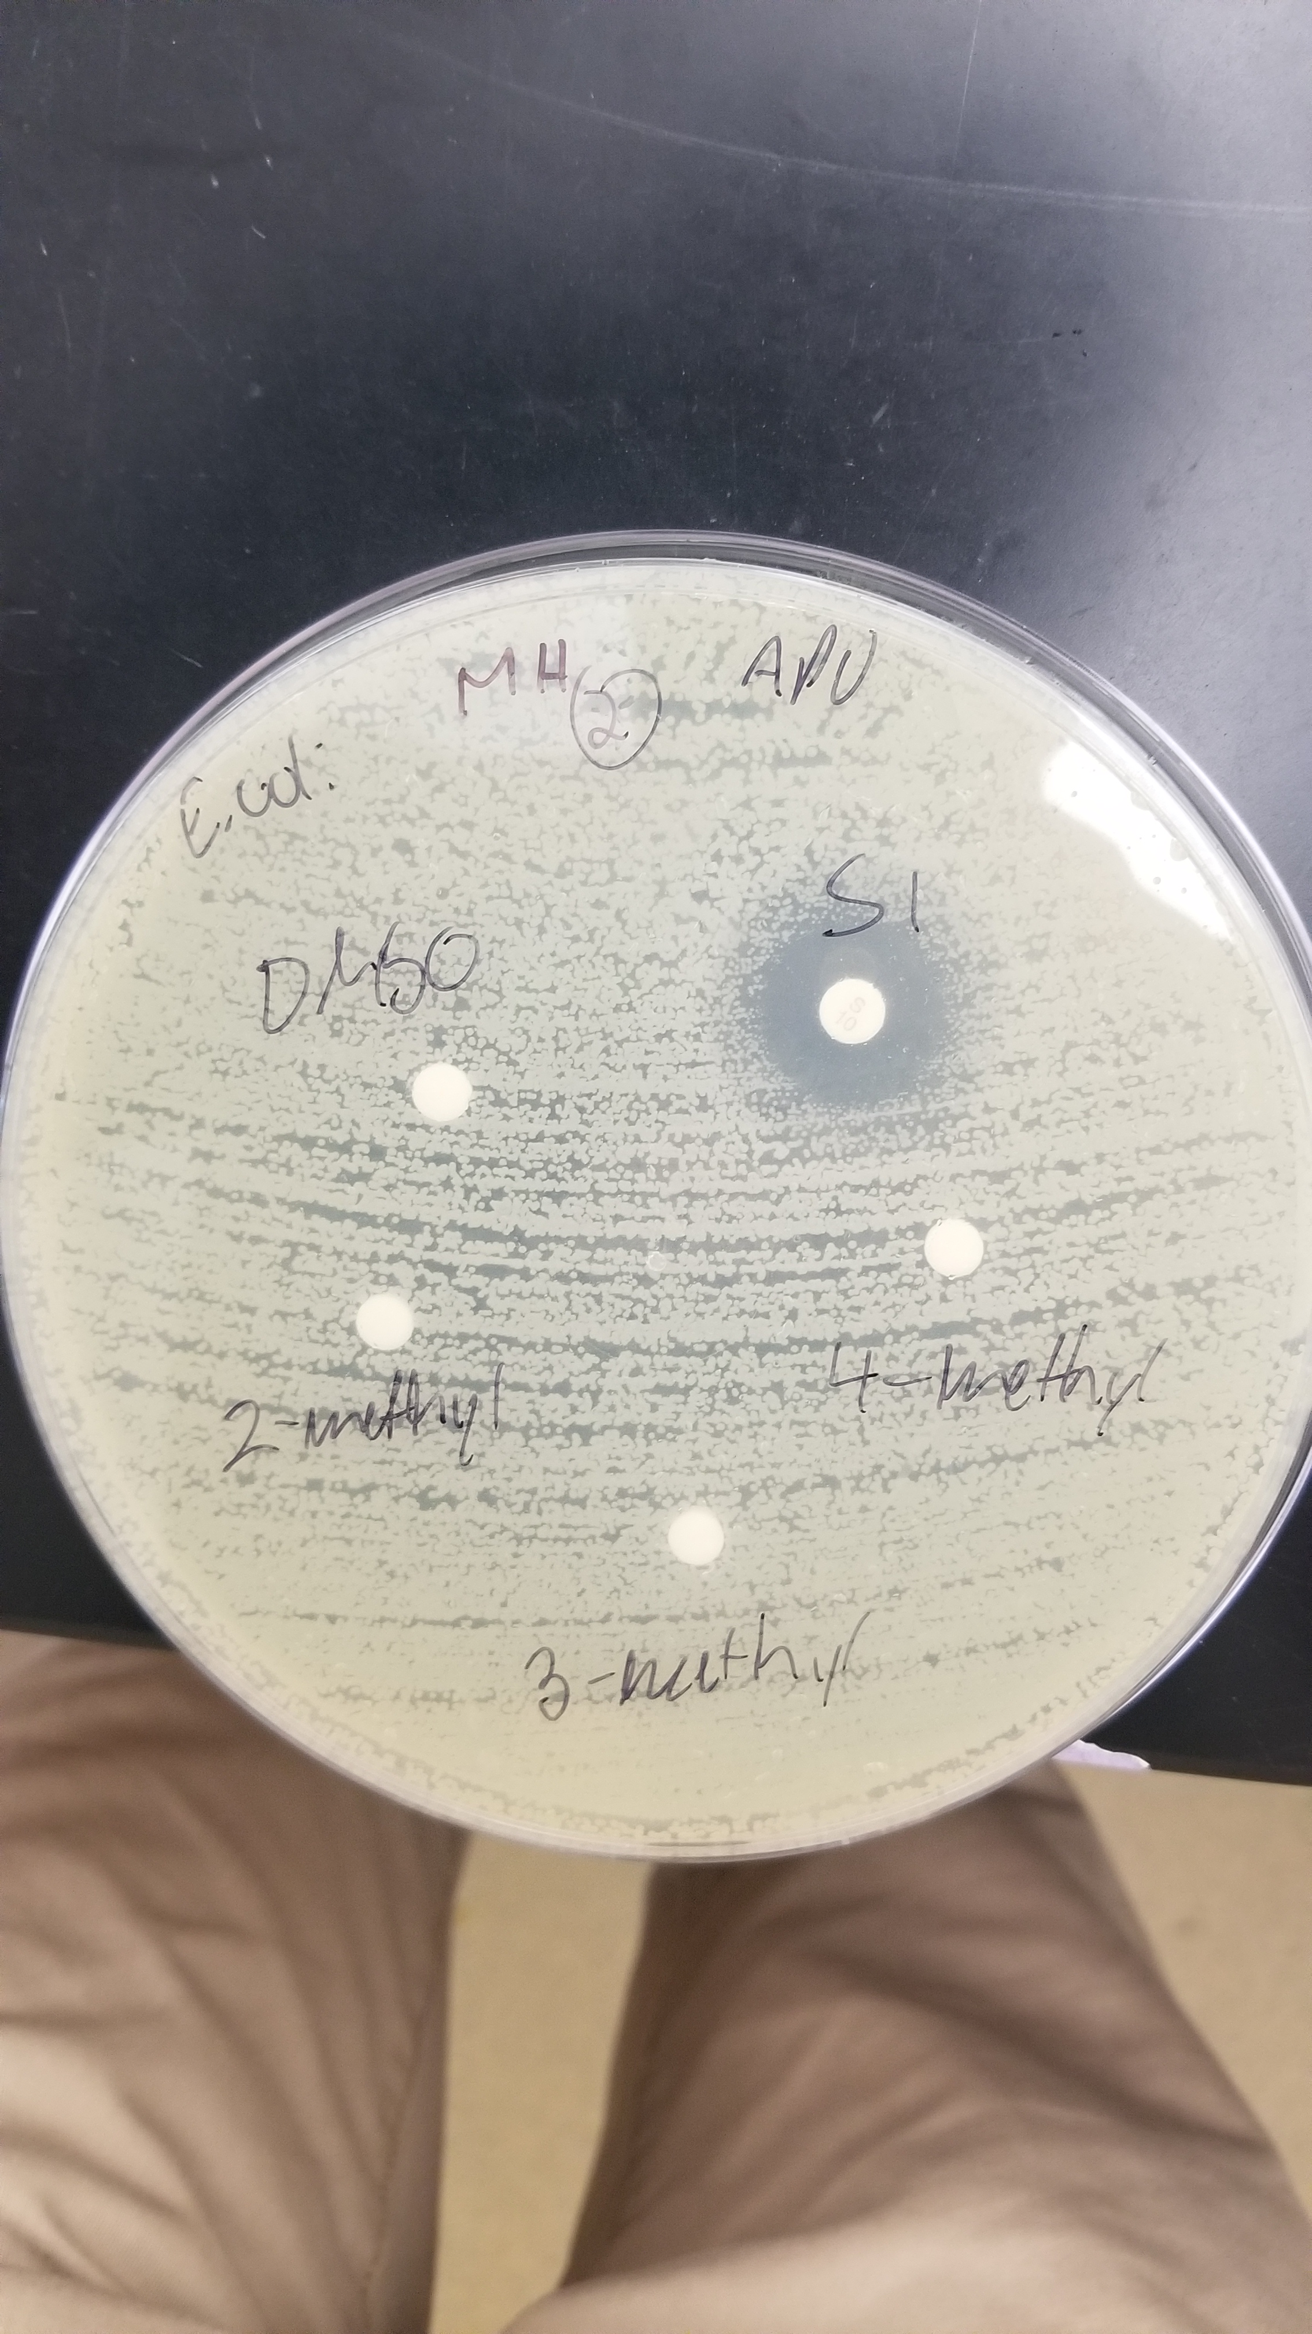
Phenylmaleimides (Loyd Bastin)
Aidan Looby, Sebastian Cuka, Andrew Devany
p-, m-, o-chlorophenylmaleimide at 50 μg
p-, m-, o-methylphenylmaleimide at 50 μg
L.D. Bastin, M. Nigam, S. Martinus, J.E. Maloney, L.L. Benyack, B. Gainer, Green Chemistry Lett. Reviews 2019, 12, 127-135.

Slide 18
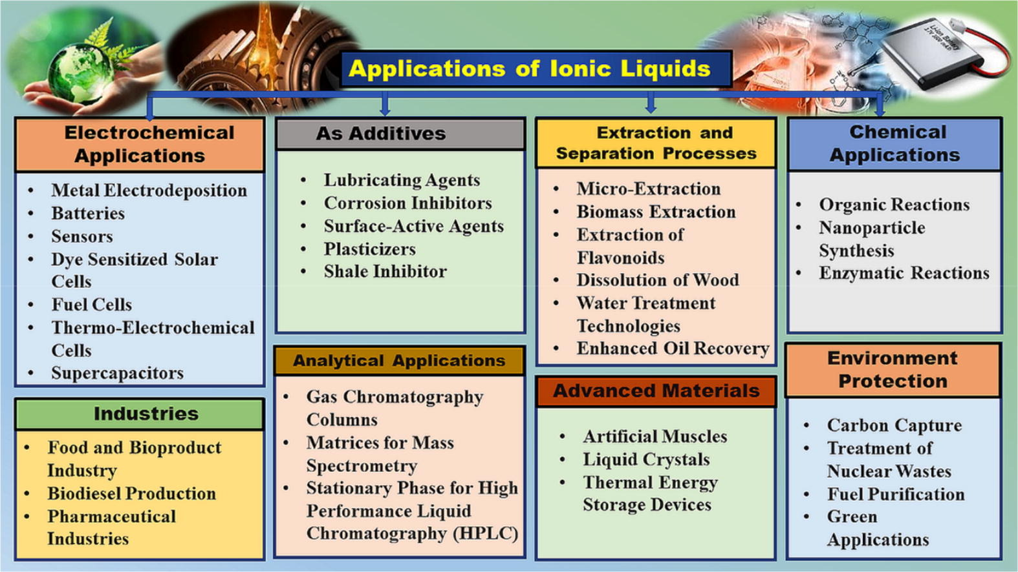
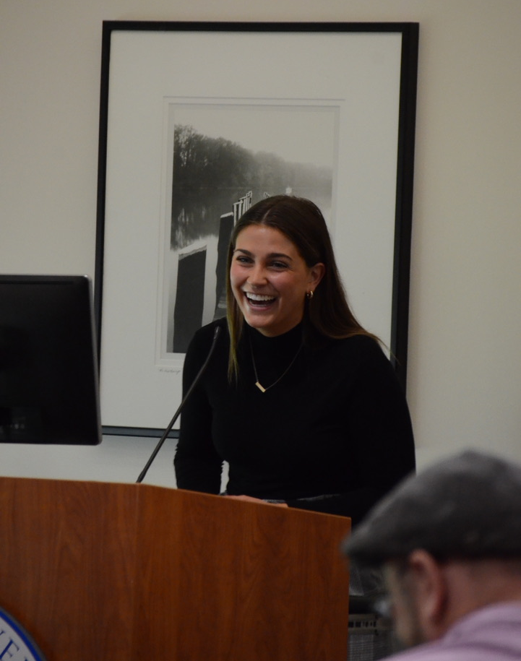
Ionic Liquid (Ismail Kul)
Compounds composed of ions with melting point below 100 °C
Can replace organic solvents
  Low viscosity
  Easiness for recovery and recycling
  Relatively inexpensive
Anna Lambert

Slide 19
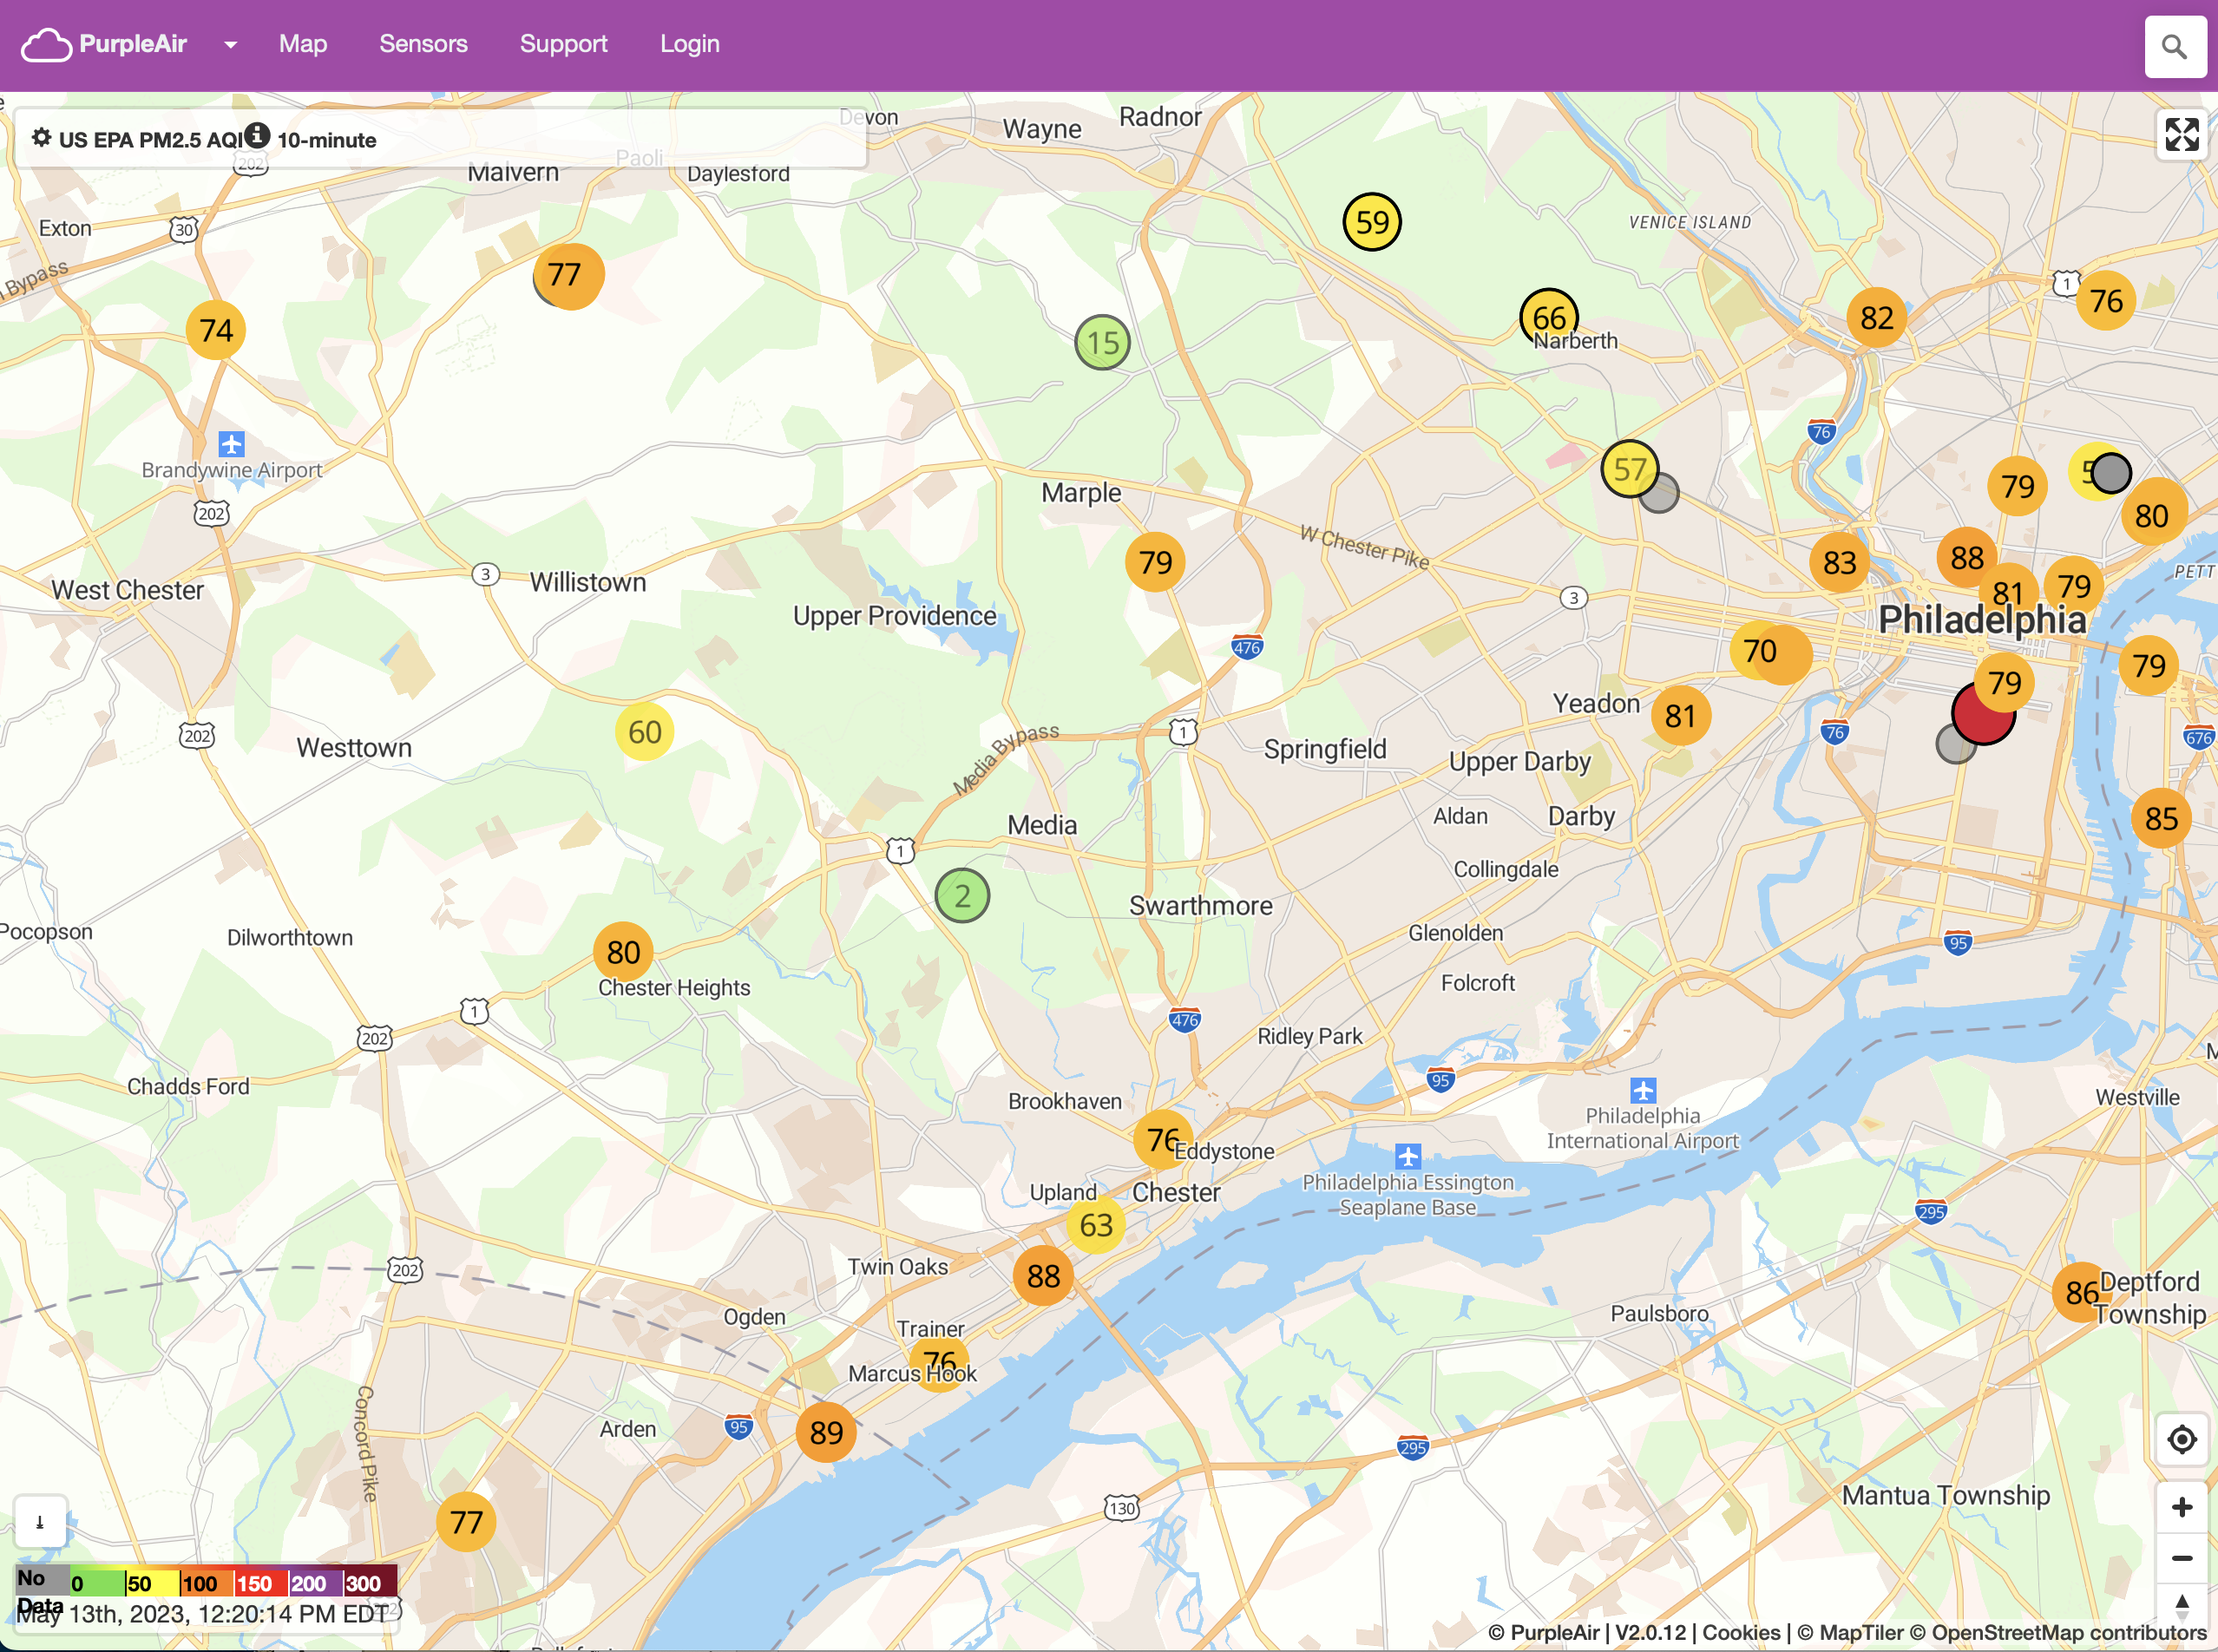
Air Monitoring (Scott Van Bramer and Xin Du)
Set stage for recent EPA grants that the PA-DEP and the clean air council received to place a large number of low cost monitors in Delaware County.

Slide 20
BS in Green Chemistry at Widener
2nd BS in Green Chemistry in the U.S. and first on the east coast
Geared towards Sustainability-conscious students with an aptitude and interest in Chemistry
Builds on the sustainability and green chemistry of our current courses.
Replaces free electives with:
  Intro to Sustainability course
  Environmental pollution course
  Environmental science course
General Education Courses
  HUM/SSCI Courses will be related to Sustainability and Social Justice, when possible
  Capstone course must be related to Sustainability
Senior research experience in Green Chemistry

Slide 21
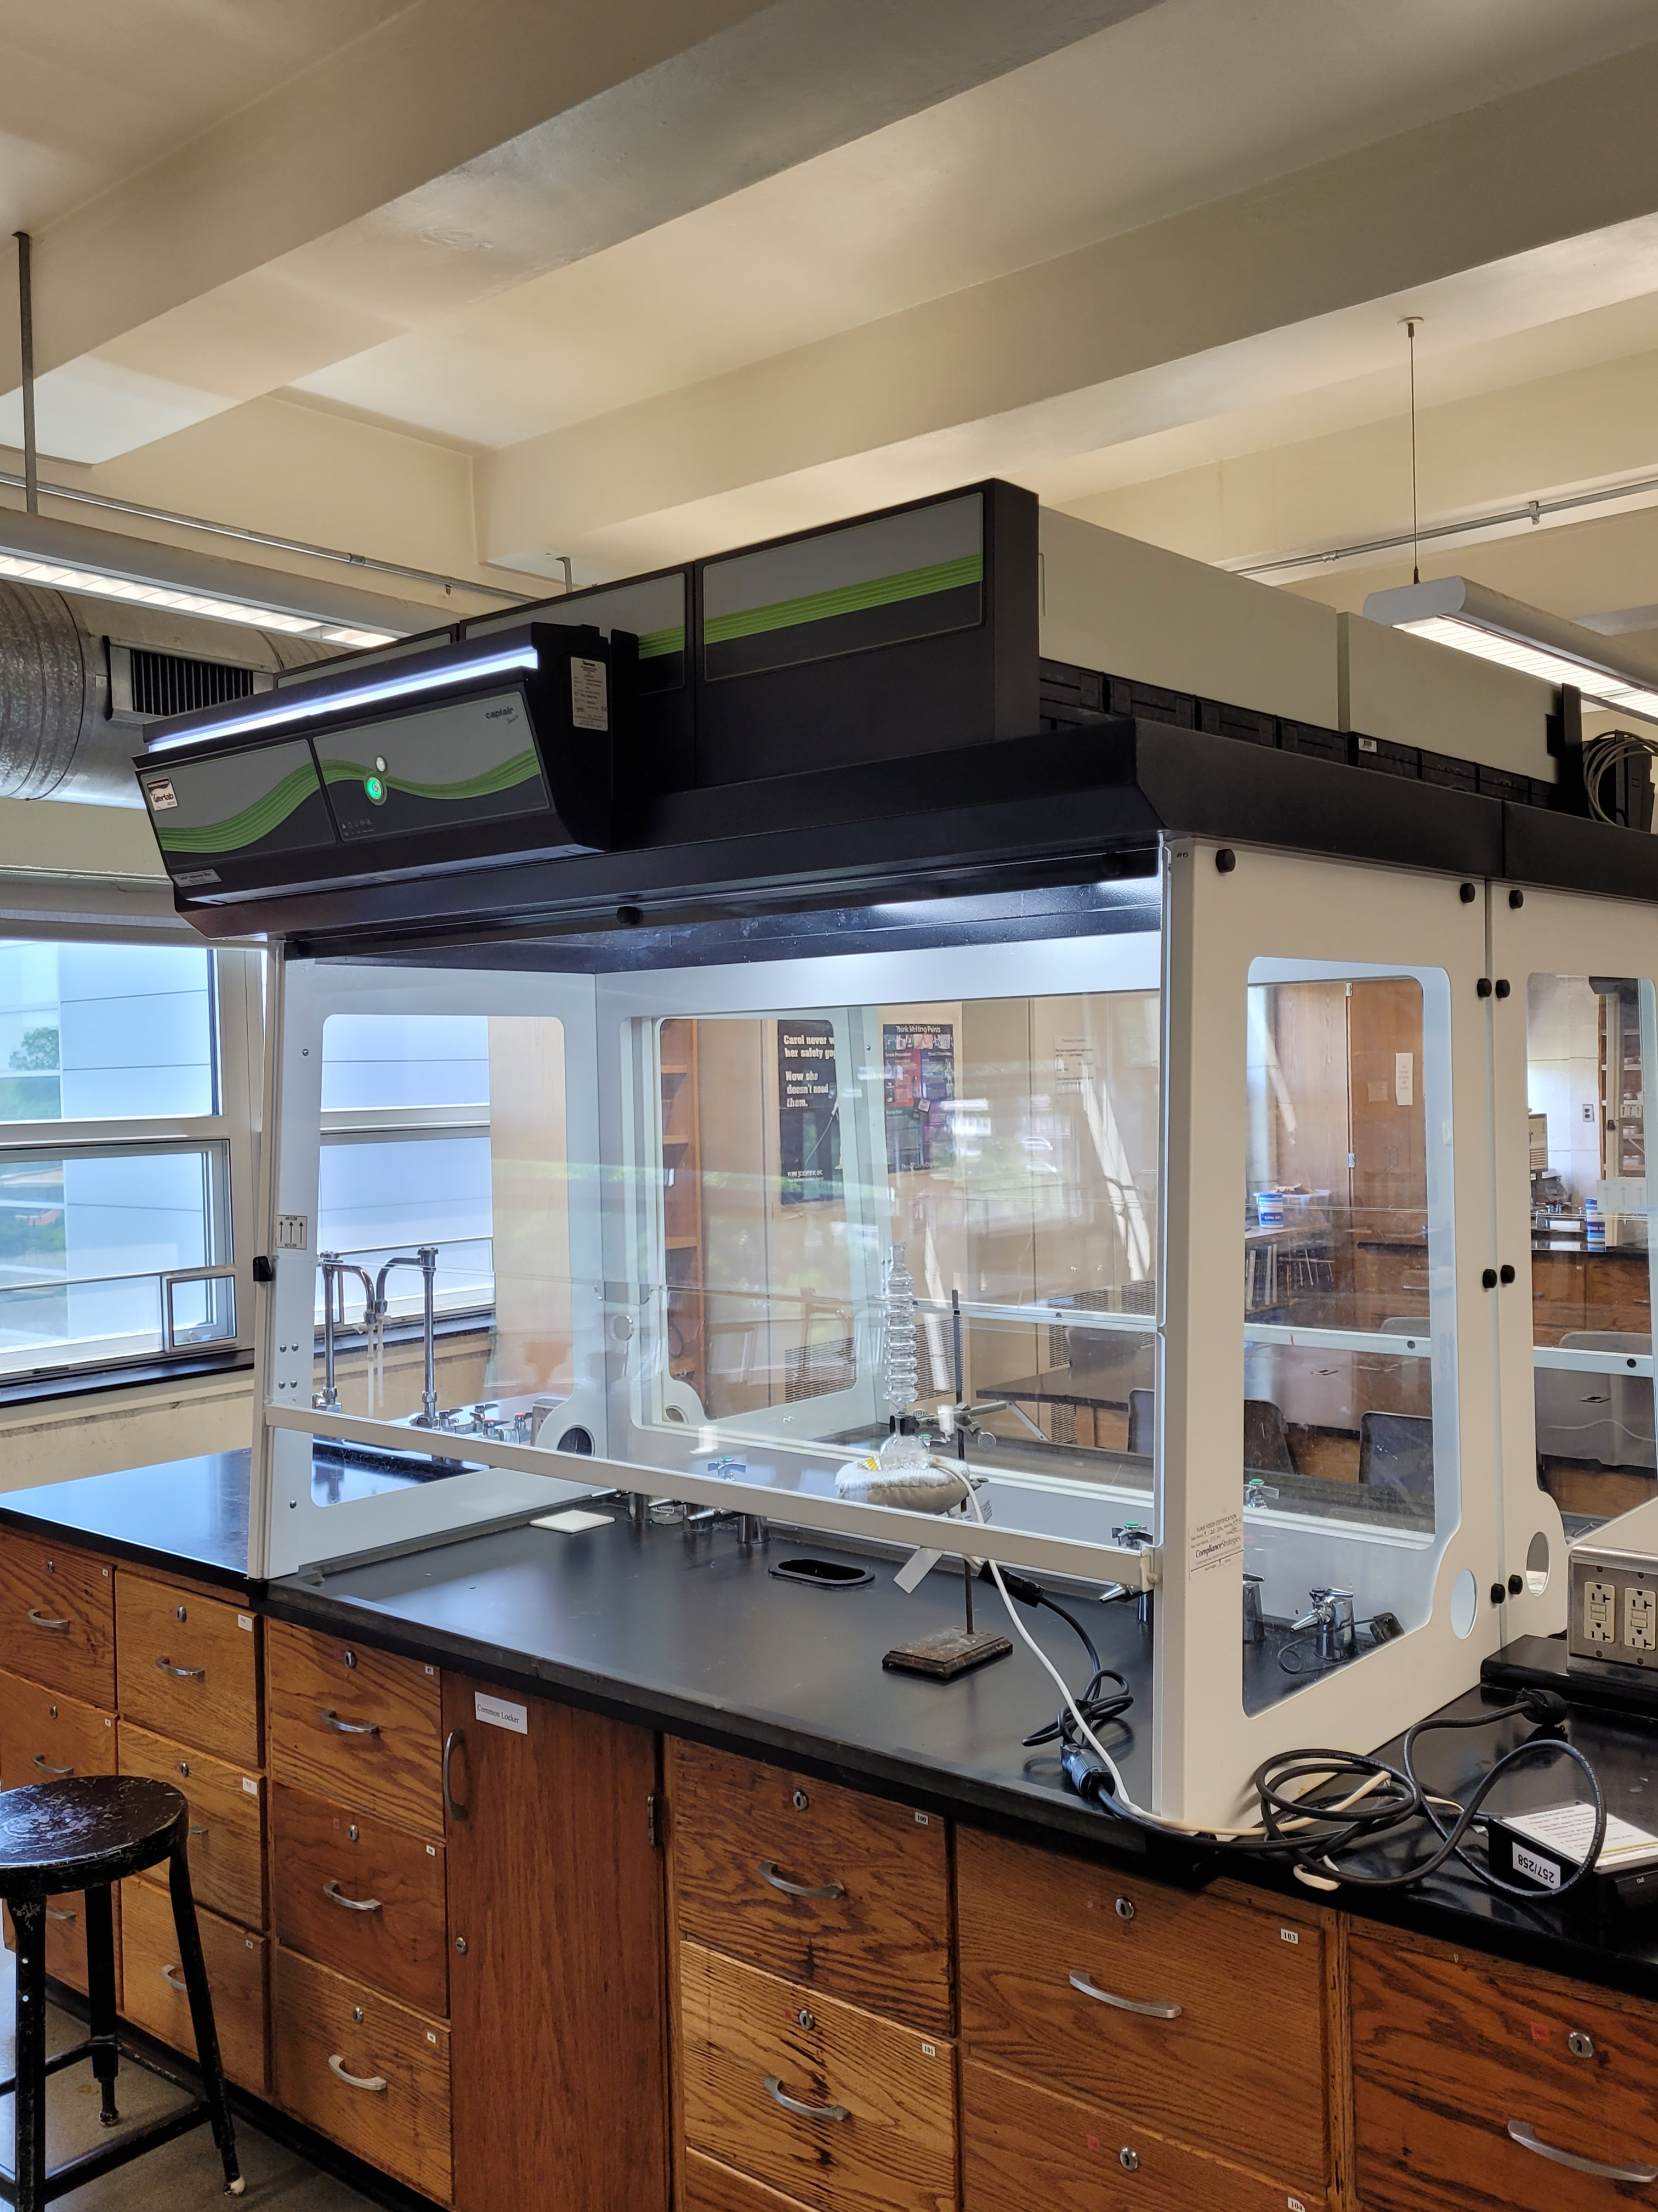
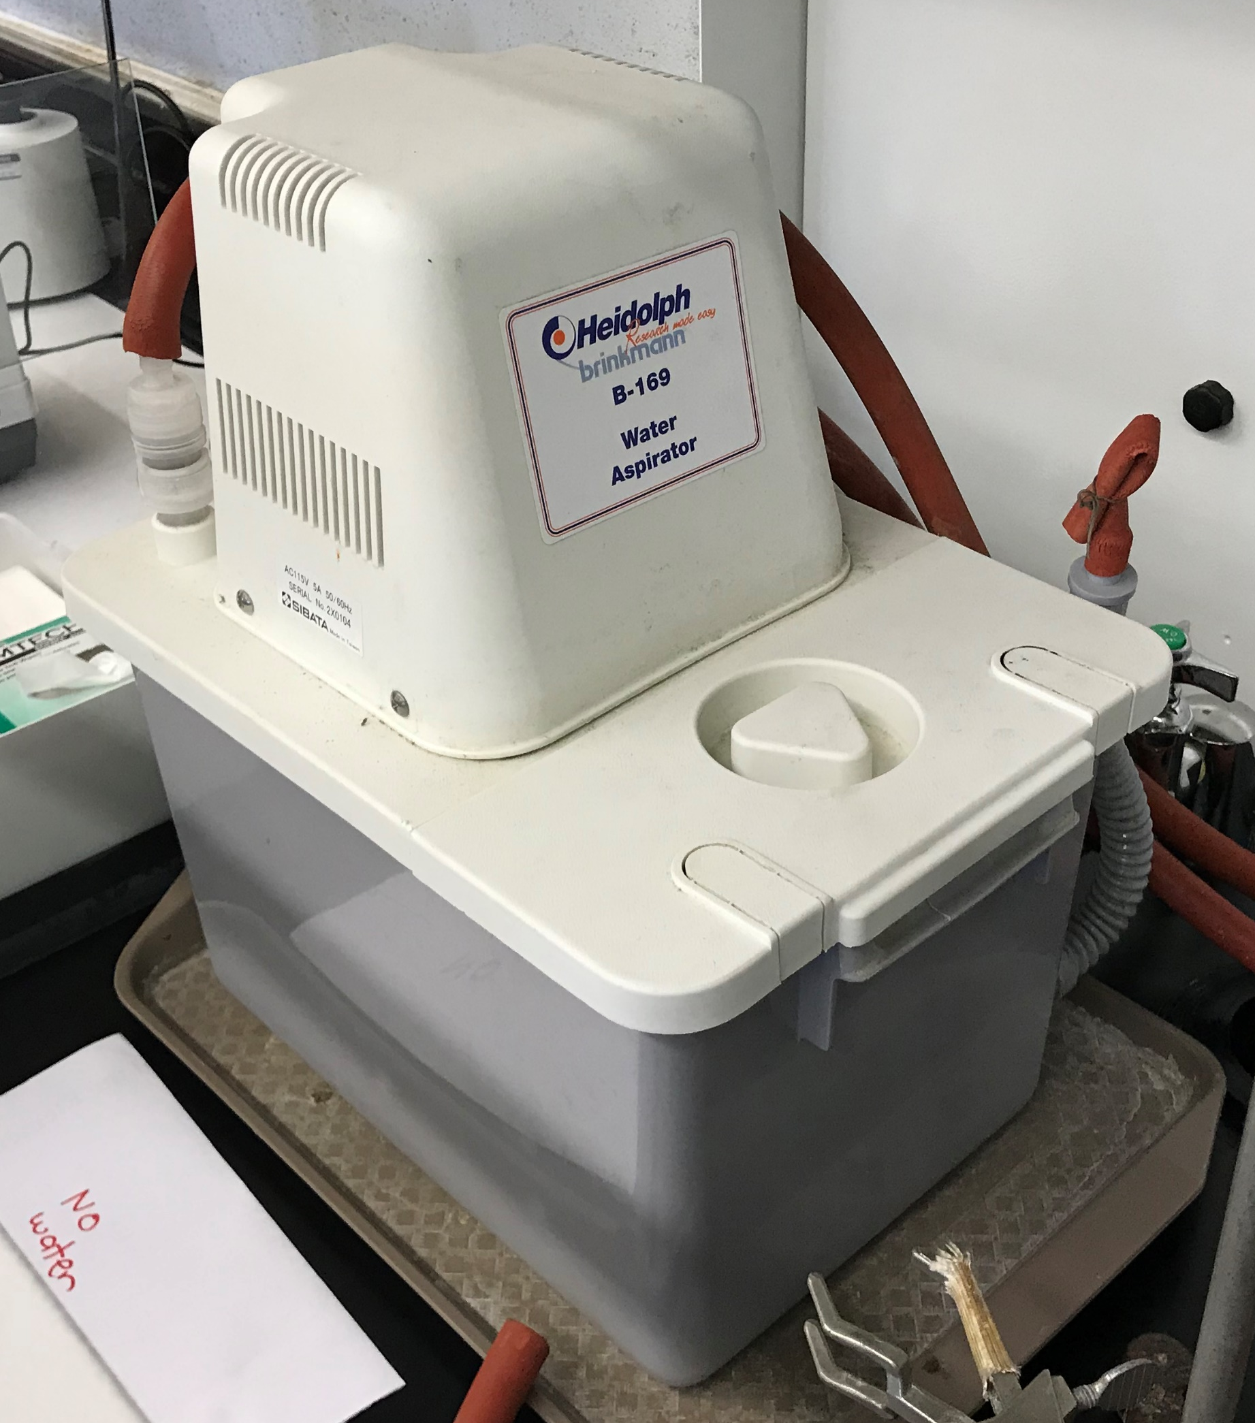
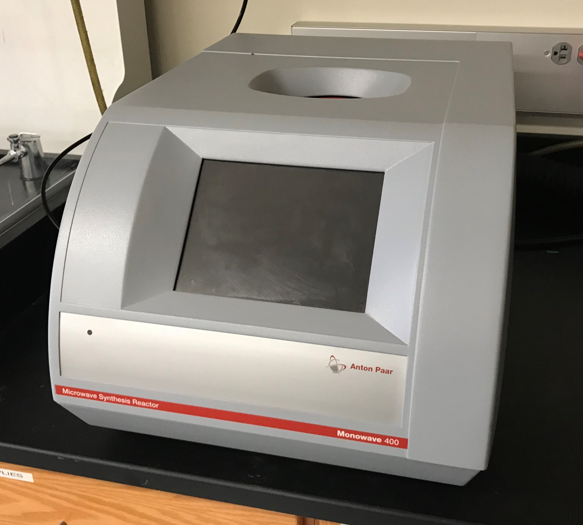
Greener Facilities
Fume hood replacement
  Replaced 50 exhaust hoods with recirculating hoods
    Reducing Widener’s energy consumption by 1400 MWh/year
    CO₂ emissions decrease of 972,000 lbs/year
    Cost savings of $58,000/year
  Biology now uses an inverted version in A&P
Recirculating water pumps
  Reduces Widener’s water use by ~105,000 gal/year
  Cost savings of ~$100,000 per year
Waterless condensers
Eliminates use of water when refluxing reactions
Purchase of an Anton-Paar Monowave 400 Reactor
  Microwave
    Sealed container
    Higher temperatures and pressure
    Reduces solvents and reaction time
  Significant energy savings for our reactions

Slide 22
Thank you!
Loyd Bastin
lbastin@widener.edu

