Slide 1

Delaware County
Budget Task Force
Public Presentation
November 10, 2025
Council:​
Dr. Monica Taylor, Chair​
Richard R. Womack, Vice-Chair​
Kevin M. Madden, Council Member​
Elaine Paul Schaefer, Council Member​
Christine A. Reuther, Council Member​
​

Slide 2

Agenda
Welcome Vice-Chair Richard R. Womack
Task Force Overview Barbara O’Malley, Executive Director
Subcommittee Reports
  Budget Presentation Barbara O’Malley, Executive Director
  Capital Investment Danielle Floyd, Director of Public Works
  Cost Containment Marc Woolley, Deputy Executive Director
  Revenue Enhancement Alyssa Mehalick
Next Steps Barbara O’Malley, Executive Director
Q & A Vice Chair Richard R. Womack

Slide 3
Task Force Composition
Conceived by Councilman Richard R. Womack in December 2024
Public Application Process –January 22, 2025 thru February 7, 2025
65 individuals applied representing various communities
All members were accepted to serve on the task force
Members indicated multiple subcommittees of interest and were assigned to a task force subcommittee based on interest and to maintain roughly equal number of participants on each subcommittee

Slide 4
Member Experience
  Business Owners
  Accountants
  Grants Manager
  Nursing
  Real Estate
  Veteran
  Marketing
  Organized Labor
  County Employees
  Church Financial Manager
  Police Officer
  Teacher
  Health Care Workers
  Township Commissioner

Slide 5
Why Do You Want to Serve?
I am interested in learning more about the overall process and in contributing to find a solution to help reduce costs
I am interested in keep costs containment and finding ways to bring money into DELCO
I believe there are appropriate private sector principles that can be applied to the public sector
To help reduce costs while still maintaining services
I would like to understand how the County budget is calculated (Needs vs. Wants)
I want to see our community continue to thrive, but I know that rising taxes can be daunting
I’ve lived in Delco for over 50 years, am vested in it, would like to have money to provide programs and services for residents
To assist in seeking ways to reduce costs of taxpayer funded programs
I want to help the County solve its budget issues while bringing complete transparency to the budget process.
To gain an understanding of how tax dollars are spent and to avoid another tax increase
I would like to serve…because I’m passionate about ensuring that our community’s resources are allocated effectively and equitably
To balance the budget, spend less than what is collected

Slide 6
Key Task Force Accomplishments
Over 40 meetings held among all committees
Site Visit to County Assets
  Delaware County Health Department in Yeadon
  Fair Acres Geriatric Center
  Office of the Medical Examiner
  Rose Tree Park (County Parks Headquarters)
Presentations from:
    County Treasurer Central Purchasing Department
    Economic Development Corporation Health Department(DCHD)
    Public Works Director Parks and Recreation
    G.W. Hill Fair Acres
    Department of Emergency Services Medical Examiner’s Office
    Human Resources ClearGov

Slide 7
Subcommittee Update
Budget Presentation
Capital Investment
Cost Containment
Revenue Enhancement

Slide 8
Budget Presentation Subcommittee
Composition and Operation
Consisted of 14 community members
Met every other week – hybrid or virtual
Reviewed 2024 County Budget PowerPoint Presentation Slide by Slide
Analyzed the County Budget Expenditures Categories
Analyzed the County Budget Revenue Categories
Received a presentation from Clear Gov
Developed recommendations

Slide 9
Budget Presentation Subcommittee
Recommendations
Focus budget presentation on how funds are spent
Add information on county operations-mandated services
Recategorize expenditures for clarity
Recategorize revenue for clarity
Conduct day and evening public budget hearings
Make draft budget available online
Create Department Profiles

Slide 10
Budget Presentation Subcommittee
New Categories for Expenditures
Previous Categories
General Government
Finance and Budget
Information Technology
Community Justice and Rehabilitation
Community Supports and Services
Emergency Services
County Court System
Debt Service
Employee Benefits
Insurance
Other County Expenditure
Other Subsidies
New Categories
Government & Administration
County Services
Prison
County Court System
Debt Service
Employee Benefits
Insurance
Tax Refunds
Subsidies

Slide 11
Budget Presentation Subcommittee
New Categories for Revenue
Previous Categories
Taxes
Licenses and Permits
Intergovernmental Revenues
Charges for Services
Fines and Forfeits
Miscellaneous Revenue
Other Revenue
New Categories
Taxes
Gaming Revenue
Local, State, Federal Funding
Charges for Services
Fines and Forfeits
Rental Income
Opioid Trust Funding
Other Revenue
Notes:
Misc revenue=$8.5, Other=$10.8. Now only ‘Other Revenue’=$4.2

Slide 12
Budget Presentation Subcommittee Recommendations: Public Engagement
Create online opportunities for residents to ask questions and receive answers regarding the budget
Create manual/paper format to ask questions and receive answers regarding the budget
Create a Citizens Budget 101 Program
Consider purchase of ClearGov or similar transparent reporting tool
Promote budget and budget Q&A on social media
Conduct public engagement regarding budget
Conduct public engagement regarding county operations and topics of interest (how taxes work, budget process, etc.)

Slide 13
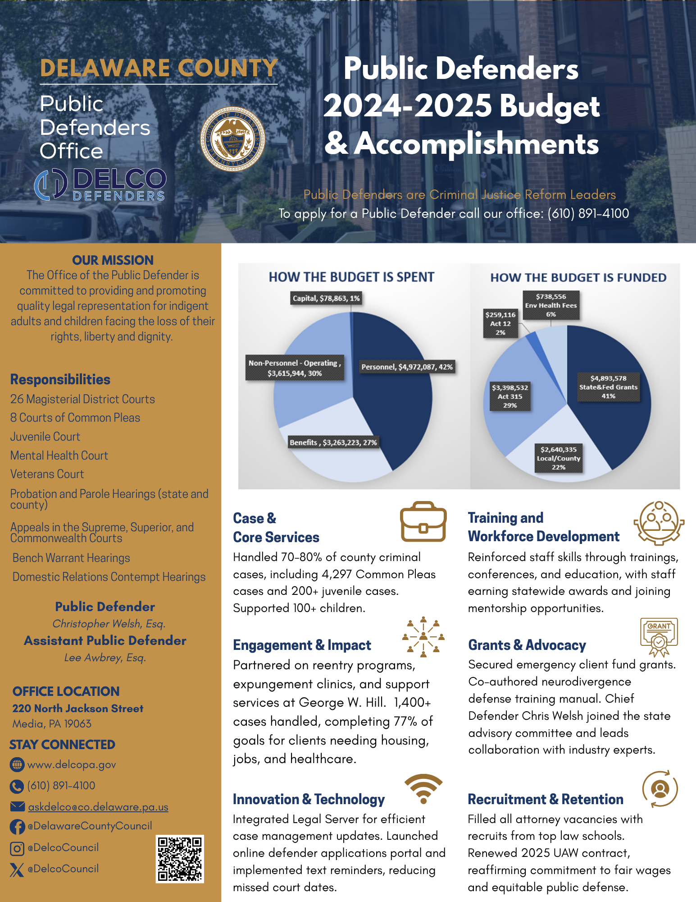
Delaware County One-Page Profiles
Sample Profile

Slide 14
Capital Investments Subcommittee
Composition and Operation
The capital subcommittee is comprised of 15 members.
The committee learned about the County’s infrastructure needs, reviewed how the capital budget is developed and projects prioritized for inclusion in the budget, and discussed opportunities for process improvements.
Guest speakers included the FCNA (Facilities Condition Needs Assessment) Project Manager, Financial Consultants from Keystone Municipal Services, and the Public Works Finance Manager.
Meetings were in-person and virtual via Zoom.

Slide 15
The Capital Subcommittee held 7 meetings from April through August.
April 1, 2025
Kickoff Meeting
FCNA Overview (pt. 1)
April 22, 2025
May 6, 2025
Capital budgeting timeline and process
June 4, 2025
Capital budget process
June 11, 2025
Building condition and future uses
Subcommittee recommendations
July 8, 2025
Subcommittee recommendations
August 26, 2025
Subcommittee recommendations
FCNA Overview (pt. 2)
Best Practices in Capital Budget Management

Slide 16




County Facilities Tour
On June 3, 2025, representatives from the Budget Taskforce toured select County facilities to gain a deeper understanding of the County’s capital needs.
  Delaware County Health Department in Yeadon
  Fair Acres Geriatric Center
  Office of the Medical Examiner
  Rose Tree Park (County Parks Headquarters)

Slide 17
What is the capital budget?
The capital budget is a financial plan that details how the County will invest to sustain operations at its 85 facilities and 15 parks.
  The budget is informed by data from the Facilities Condition & Needs Assessment that was completed in 2021/22.
  The budget supports County strategic initiatives, replacement of critical building systems, the purchase of new equipment and software to support the delivery of services to County residents.
The capital budget is/will be funded using the proceeds from general obligation debt.
The budget is adopted by County Council annually in December per the County administrative code.

Slide 18
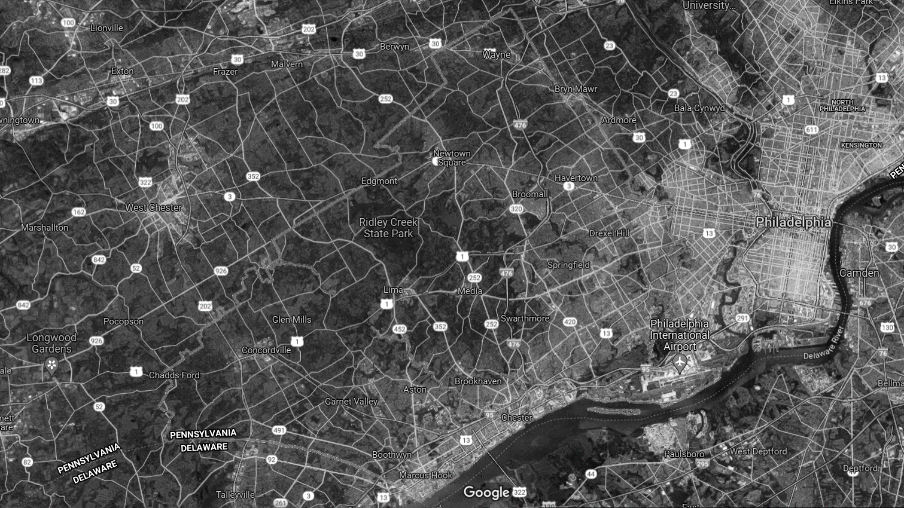








85 facilities
Delaware County Courthouse Complex
nearly 2.5 million sf of space
Fair Acres Geriatric Center
Lima Campus
15 parks
George Hill Correctional Facility
Emergency Services Training Center
631 acres of park land
Chester City
4.4 miles of trails
County Parks

Slide 19
How are the County’s budget priorities determined?
County Council Strategic Initiatives
Support of County Operations
Steering Committee Guidance
Proposed Capital Budget
Healthy & Safe Communitiess Government Reform
Criminal Justice Reform
Sustainability
Open Space Preservation
Health & Life Safety
Regulatory/Legal Compliance
Operational Efficiencies
Leveraging External Funds
Funding Limits
Operational Efficiencies

Slide 20

Delaware County has increased its capital investment over the last 3 years to address the deferred maintenance backlog.

Slide 21
Recommendation Categories
External Communication & Stakeholder Engagement
Flexible and Adaptable Budgeting
Proactive Planning
Data Management

Slide 22
External Communication & Stakeholder Engagement
Recommendation: Build off the launch of the new County website to create a user-friendly webpage about the capital budget and capital investments.
Create a Frequently Asked Questions document
Post links to Budget documents
Make it easy one stop shopping; the word “capital” is not currently searchable
  Time Frame: Immediate, can be completed prior to adoption of FY2026 budget.
  Feasibility: High impact, somewhat challenging to implement due to staff availability and workload.
  Desirability: This recommendation is likely to be supported and welcomed by residents.

Slide 23
External Communication & Stakeholder Engagement
Recommendation: Develop a clear message about “Why Now”. Identify clear benefits to the public. The County must go on the offense with its messaging. Don’t rely on attendance at Council meetings to get information out.
Consider the addition of communications/PR staff to tell the story about the County’s budget with an exclusive focus on stakeholder outreach
Implement a Public Information campaign
Use County social media to tell the County’s story about its capital investments
Use infographics that show how taxpayers funds are allocated
Delineate between capital budgets and operating budgets. Ensure that the differences are clear and explain how they address different types of needs.

Slide 24
External Communication & Stakeholder Engagement
Recommendation: Develop a clear message about “Why Now”. Identify clear benefits to the public. The County must go on the offense with its messaging. Don’t rely on attendance at Council meetings to get information out.
  Time Frame: Short-term. Unlikely to be fully implemented prior to adoption of FY2026 budget. Plan for full implementation in conjunction with planning for the FY2027 budget.
  Feasibility: High impact, can build support for future revenue enhancements.
  Desirability: This recommendation is likely to be supported and welcomed by residents.

Slide 25
Flexible and Adaptable Budgeting
Recommendation: Make the capital budget more of a living document with the ability to be more flexible given federal, state, regulatory, or policy changes.
County must plan and budget for the unknowns.
Be able to pivot.
  Time Frame: Short to mid term.
  Feasibility: Varies. Will require additional resources to complete the analysis. Difficult to predict shifts in funding priorities or regulatory requirements beyond a single budget cycle.
  Desirability: Varies. Likely to be welcomed by County finance and budget staff but may create additional stress on the operating budget. Will raise budget contingency.

Slide 26
Flexible and Adaptable Budgeting
Recommendation: Articulate the cost to bring County facilities up to a state of good repair and demonstrate what that cost is over a period of time.
Maintain a schedule of anticipated future needs.
Provide residents more information about what it requires to care for the County’s physical plant.
Explain the costs and risks when failing to address infrastructure needs. Provide a historical perspective that informs residents about the state of County infrastructure. (Example: “Project X is on the list for X years; explain why it was deferred and cost implications”)
Use benchmarks to frame the historical perspective without bias. Provide a few examples of industry standards and show where the County is relative to that standard.

Slide 27
Flexible and Adaptable Budgeting
Recommendation: Articulate the cost to bring County facilities up to a state of good repair and demonstrate what that cost is over a period of time.
  Time Frame: Short to mid term.
  Feasibility: High impact, can build support for future revenue enhancements. Analysis will require additional staffing or external resources.
  Desirability: Varies. Likely to be welcomed by Council and County finance and budget staff when establishing funding priorities.

Slide 28
Proactive Planning
Recommendation: Require County departments to demonstrate and explain how the capital investment advances the County and/or department’s mission & strategic plan.
Capital investments should align with operational planning and talent recruitment efforts.
  Time Frame: Immediate. Implemented as part of the 2025 capital budget call.
  Feasibility: High impact when done with fidelity. Creates direct linkage between capital investments and County operations.
  Desirability: This recommendation is likely to be supported and welcomed by residents because it provides greater transparency and holds County departments accountable to document their needs. Challenging for County departments that do not currently have a written plan or clear mission statement.

Slide 29
Data Management
Recommendation: Plan for a refresh of the Facility Condition and Needs Assessment.
The data will be five years old in 2027.
Best practice is to refresh all or portions of the data every 3-5 years.
Ensures greatest needs continue to be prioritized and addressed.
  Time Frame: Long term.
  Feasibility: High impact, maintains appropriate focus for capital investments and relevancy of the data use to inform the capital budget. Creates risk mitigation and informs total cost of ownership. Analysis will require external resources.
  Desirability: Varies. Likely to be welcomed by Council and County finance and budget staff when establishing funding priorities. Provides actionable, data-driven information to make sound decisions about maintenance, repairs, and upgrades.

Slide 30

Executive Summary
Key Outcome: Fiscal stabilization through efficiency, transparency, and reinvestment.
Purpose: slow cost growth without degrading service quality.
Scope: HR/benefits, corrections, facilities & leases, procurement, fleet, telecom/IT, Fair Acres, grants management.
Approach: pragmatic reforms + dashboards + policy locks; pair efficiencies with modest, predictable revenue adjustments.
Outcome: stabilize costs; protect core services; reinvest a portion of savings in workforce and infrastructure.

Slide 31
Background of our Approach
Reviewed countywide cost drivers through data, budgets, and stakeholder input across seven (7) meetings.
Engaged key dept heads such as Central Purchasing, HR, GWH, DCHD, DCOME, DES, & Fair Acres.
Used spend analyses, benchmarking, and Lean Six Sigma tools to identify waste and duplication
Leveraged existing tools and successful practices already in place
Prioritized recommendations by feasibility, desirability, and implementation timeframe
Focused on sustainable, policy-based reforms, not one-time savings

Slide 32
Implementation Timeframes
Timeframe | Definition
Immediate (≤ FY2026) | Quick to launch; policy/process changes; minimal capital.
Short-term (1–2 years) | Requires planning, contracting, or staffing shifts.
Long-term (2+ years) | Capital projects, major system changes, CBAs.

Slide 33
Evaluation Criteria
Dimension | Meaning
Feasibility | Difficulty to implement given systems, staffing, and capital needs.
Desirability | Likelihood of stakeholder support (Council, workforce, public).
Impact | Magnitude of savings/avoidance or risk reduction.

Slide 34
Cost Containment Impact Overview
Category | Feasibility | Impact | Timeline | Progress and Notes
HR / Benefits Reform | Medium | High | Immediate | Already implemented
Procurement & Central Purchasing | High | High | Immediate | Already showing results
IT and Telecom | High | Medium | Immediate | Already showing results
Fleet | High | Medium | Immediate | Already showing results
Grants Administration | Medium | High | Short-term | Resource investment required
Prison | High | High | Short-term | Resource investment required
Facilities & Leases | Medium | Medium | Immediate | Campus Plan is initiated

Slide 35
Retirement & Benefits Reform
Key Actions
Action | Timeline | Feasibility | Desirability | Progress of Goals | Notes
Dependent Eligibility Audits | Immediate | High | Medium–High | Launched | Remove ineligible dependents; enforce coordination of benefits.
Spousal Surcharge | Immediate | Medium | Medium | Launched | Apply surcharge when spouses have employer coverage.
Retiree Cost Sharing (Grand-fathered) | Short-term | Medium | Medium–High | Early stages | Modest premiums/co-shares with hardship protections.
Pharmacy Spend Controls | Immediate | High | High | Launched | Coalition pricing, generics-first, clinical mgmt.
Plan Migration (HDHP + HSA) | Immediate | Medium | Medium | Launched | Incentivize adoption with calibrated HSA contributions.

Slide 36
Compensation Management
Key Actions
Action | Timeline | Feasibility | Desirability | Progress of Goals | Notes
CBA Scenario Modeling | Short-term | High | High | Early stages | Model base/COLA/steps; align with fiscal capacity.
Contract Design for Predictability | Short-term | Medium | Medium–High | Early stages | Longer terms; alternative COLA formulas.
Non-Rep Merit/COLA Framework | Immediate | High | High | Launched | Transparent pay philosophy tied to market + performance.
Evaluation of Vacancies | Short-term | Medium | Medium | Early stages | Strict backfill rules to avoid rebound costs.

Slide 37
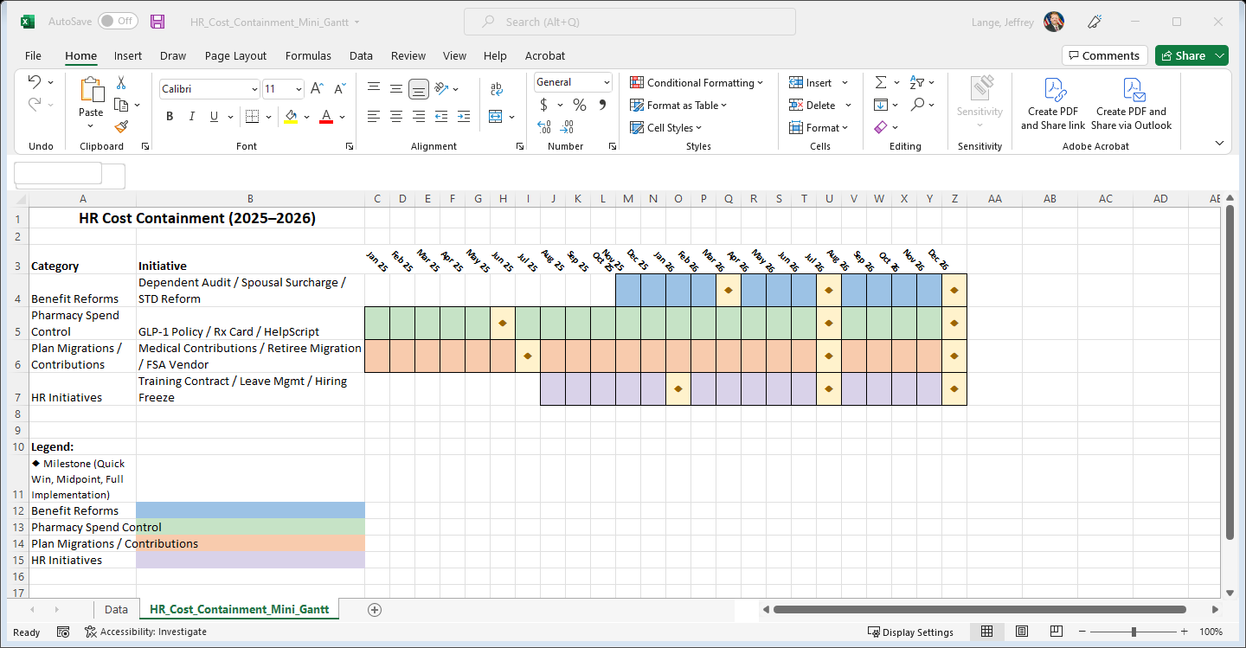
Human Resources Timeline Goals

Slide 38
Facility & Lease Campus Plan Review
Actions
Action | Timeline | Feasibility | Desirability | Progress of Goals | Notes
Portfolio Inventory & Total Cost of Ownership Analysis | Short-term | High | High | Early stages | Include renovation/readiness, lifecycle, utilities.
Co-location & Space Standards | Immediate | Medium | High | Launched | Consolidate where functionally aligned; avoid duplications.
Lease vs Own Decisions | Short-term | Medium | High | Early stages | Use readiness and lifecycle costs, not sticker price.
Energy Efficiency Retrofits | Immediate | High | High | Launched | LED, controls, envelope; embed in CIP.

Slide 39
Prison and Revenue Enhancement
Action | Timeline | Feasibility | Desirability | Progress of Goals | Notes
Overtime Reduction (Scheduling/Staffing) | Short-term | Medium | High | Early stages | Optimize staffing and scheduling
Telemedicine & MAT Efficiencies | Short-term | High | High | Early stages | Lower ER transports & offsite care costs.
Insurance Utilization (Non-emergency) | Short-term | Medium | Medium | Pending | Use inmate insurance when available.
Renovate range for all County LE & eliminate costs at current pay for use range | Short-term | Medium | High | Pending | Pair with CIP upgrades & legal review.
Monetize recent renovations & reduce overall operating expenses (Host USMS housing/training center) | Short-term | Medium | High | Pending | Pair with CIP upgrades & legal review.

Slide 40
Countywide Grants Management Goals- Actions
Action | Timeline | Feasibility | Desirability | Progress of Goals | Notes
Create Grants Administrator (CFO) | Short-term | Medium | High | Early stages | Single hub for applications, compliance, drawdowns.
Standardize Grant Playbook | Short-term | High | High | Early stages | Calendars, templates, reporting cadence / compliance, ensure reimbursement
Reduce Third-party Reliance | Short-term | Medium | Medium–High | Early stages | Build internal capacity

Slide 41
Procurement & Contract
Consolidation Goals- Actions
Action | Timeline | Feasibility | Desirability | Progress of Goals | Notes
No PO = No Pay | Immediate | High | High | Launched | Route all acquisitions via Central Purchasing.
Managed Print + Contract Consolidation | Immediate | High | High | Launched | Copiers/printers; reduce desktop units; usage analytics.
Strategic Sourcing via cooperative agreements (e.g.- COSTARS, Keystone purchasing network, Source-well) | Immediate | High | High | Launched | Ensure best price per unit; avoid duplicate buys.
Legal Expense Review (Solicitor) | Short-term | Medium | High | Early stages | Shift appropriate work in-house; tighten controls.

Slide 42
Fleet & Transportation Goals — Actions
Action | Timeline | Feasibility | Desirability | Progress of Goals | Notes
Lease-vs-Purchase Study | Immediate | High | High | Launched | Already initiated- standardize replacement cycles. Projected savings is $1.5 to $2 million
Telematics & Duty-cycle Data | Immediate | High | High | Launched | Right-size fleet; pool underutilized units or sell off Current savings of $50k in the first 6 months. Additionally- EZ-pass will save roughly 50% on toll related fees.
Shared Use & Pooling | Short-term | High | High | Early stages | Expand interdepartmental sharing models.

Slide 43
Telecom & Information Technology Goals— Actions
Action | Timeline | Feasibility | Desirability | Progress of Goals | Notes
Continue Telecom Consolidation | Immediate | High | High | Launched | Lock enterprise plans; decommission unused lines. Telecom savings reduced from 5 million to 2 million. Goal is under a million in total cost
Eliminate Desktop Printers | Short-term | High | High | Early stages | Push to secure MFDs with analytics.
ERP & Workflow Automation | Short-term | Medium | High | Early stages | E-invoicing, e-procurement, digital signatures.
Elimination of old Technology (fax, docking stations etc.) | Short-term | Medium | High | Launched | Converted to existing new technology

Slide 44
Cross-Cutting Solutions
Establish Strategic Performance function coordinated by the CFO (Lean Six Sigma, planning, dashboards, policy locks).
Grants Administrator centralized within CFO; phase in analyst capacity.
Department head bootcamps (strategy + change management).
Annual Efficiency Reviews and public dashboards; Cost Containment Reserve for reinvestment.
Embed change management practices to ensure adoption and sustainment of efficiency reforms.

Slide 45
Leveraging the Opioid Settlement for Sustainable Operations
The County will receive Opioid Settlement funds, providing a long-term opportunity for reinvestment in public health and safety.
Recommendation: Departments should assess their operating budgets to determine eligible activities currently funded by the General Fund that could be supported or replaced by settlement funds. All costs must be approved by Opioid Trust in accordance with Exhibit E.
These funds should not simply expand services but offset existing operating costs, improving long-term fiscal sustainability.
Example – Delaware County Office of the Medical Examiner (DCOME):
Redirected settlement funds to cover toxicology testing and analytical costs, savings over 100K annually.

Slide 46
Using Capital Investment to Reduce Operating Costs
Strategic capital planning can drive long-term cost containment by reducing deferred maintenance costs.
Recommendation: Leverage CIP for initiatives that:
Replace aging infrastructure or systems with energy-efficient, low-maintenance solutions.
Consolidate facility spaces to reduce leases and maintenance overhead.
Invest in durable assets—vehicles, HVAC systems, IT infrastructure—with long life cycles and measurable ROI.

Slide 47
12-Month Implementation Roadmap
Window | Key Actions
 | Stand up Strategic Performance (CFO); hire Grants Administrator; freeze new desktop printers; launch fleet analysis; dependent audit plan; draft internal ops dashboard.
 | Consolidate print & telecom; GWH maintenance alignment with CIP; grant calendar & drawdowns; pilot Lean projects.
 | Public dashboard; spousal surcharge & HDHP expansion; policy locks; Reserve Fund; shared services MOUs; annual analysis & efficiency reports by department heads for sustainability efforts.
0–90 Days
Quick Wins
90–180 Days
Build Phase
180–365 Days
Institutionalize

Slide 48
Conclusion
Pair
Pair targeted efficiencies with institutional capacity (dashboards, policy locks, grants).
Protect
Protect workforce and service quality while stabilizing long-run costs.
Integrate
Integrate cost containment recommendations into financial planning.

Slide 49
Revenue Enhancement Subcommittee
Composition and Operation
•14 residents, including two County employees
•10 meetings, March to August
•Guest speakers included County Treasurer Jim Hackett, Economic Development Corporation Executive Director Laura Goodrich Cairns, Public Works Director Danielle Floyd, Interim Parks and Rec Director Anne Stauffer, and Warden Laura Williams
•Explored both non-tax and tax revenue opportunities related to leveraging county assets, improving collections, expanding the tax base, fines and fees revenue, and seeking out additional external funding

Slide 50
County Revenue
Entity | 2024 | 2025 | % Change
Taxes | $183,080,000 | $226,567,520 | 23.8
Licenses & Permits | 5,510,650 | 4,713,650 | (14.5)
Intergovernmental | 11,650,716 | 12,407,216 | 6.5
Charges for Services | 13,443,320 | 14,947,320 | 11.2
Fines & Forfeitures | 2,819,815 | 2,875,800 | 2.0
Miscellaneous | 9,479,588 | 8,559,985 | (9.7)
Rents & Royalties | 805,911 | 910,000 | 12.9
Transfers | 510,000 | 8,206,945 | 1,509.2
Other | 25,827,244 | 28,143,197 | 9.0
Fund Balance | 37,803,209 | 14,024,193 | (62.9)
TOTAL REVENUES | $290,930,453 | $321,355,826 | 10.5

Slide 51
Limitations on Revenue Generation
Delaware County is governed under the Commonwealth’s Second Class County Code as a Second Class A County
Counties in Pennsylvania have “all their eggs in one basket” so to speak, in that the county property tax is the only source of local general fund revenues from a tax perspective
“The tax levied in counties of the second class A shall be for the purpose of creating a general fund to pay expenses incurred for general county purposes, for the payment of the matters connected with roads under section 16907 (relating to annual tax), for the payment of the matters connected with parks and related matters under section 16507 (relating to payment of expenses, taxation, annual fairs and State contributions).” – Commonwealth of Pennsylvania, Second Class County Code

Slide 52
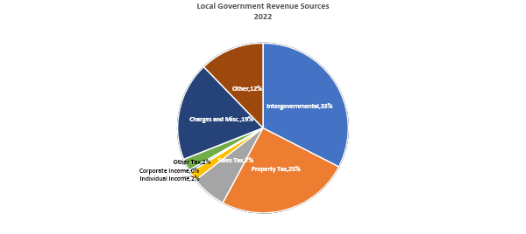
Local Government Revenue Sources
Source: U.S. Census Bureau, 2022 Census of Governments

Slide 53
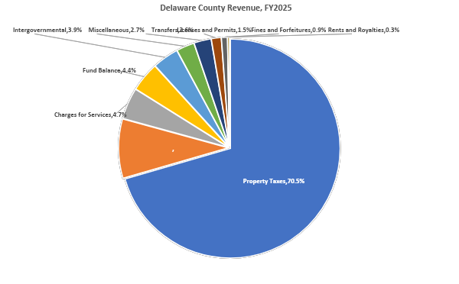
Delaware County Revenue Distribution

Slide 54
Approach
Given the statutory limitations placed on revenue generation for Second Class A counties, the group focused more heavily on non-tax sources of revenue
You will also notice that a number of recommendations require some upfront investment – spending money to make money
Recommendations are judged based on feasibility and desirability, with a possible timeline for implementation
  Time frame options include immediate (can be implemented before beginning of 2026 budget year), short-term (1-2 years), long-term (2+ years)
Notes:
High Impact, Easy to Implement: Quick wins, prioritized for immediate action.
High Impact, Hard to Implement: Strategic initiatives requiring significant resources, requiring careful planning and management.
Low Impact, Easy to Implement: Low-effort tasks, considered only if resources are available.
Low Impact, Hard to Implement: Projects to avoid or eliminate.

Slide 55
Recommendation Categories
Non-Tax Revenue Enhancement
  Enhancing Fee Structures and Improving Collection Efforts
  Leveraging County Assets
  Economic Development and Base Expansion
  Expanding External Funding
Tax Revenue Enhancement
  Advocacy for increased revenue generation flexibility
Miscellaneous
  Presentation of revenue sources in budget document

Slide 56
Enhancing Fee Structures and Improving Collection Efforts
RECOMMENDATION: Appropriate additional funds and funded positions to the County Treasury Office to allow Treasurer to add data analysis and assessment staff, expand electronic resources and databases, and pursue additional revenue enhancement best practices.
  Currently the percentage of operational cost as compared to real estate taxes collected is 1.53% compared to 2.1-3.1% for other collar counties
  This indicates underfunding of the Office responsible for the accurate collection of the County’s most significant revenue stream
  Effective assessment collection could be greatly improved if the Treasury Office has additional budgetary resources
  Time Frame: Immediate, could be included in FY2026 budget if Treasurer’s office can provide come estimate of potential revenue upside
  Feasibility: High impact, somewhat challenging to implement due to financial outlay required
  Desirability: This recommendation more likely to receive pushback due to financial outlay required
Notes:
Can Treasurer estimate how much revenue upside there might be to increasing that Department’s budget?

Slide 57
Enhancing Fee Structures and Improving Collection Efforts
RECOMMENDATION: Require all fine and fee-collecting departments to reassess their fees every other year to ensure similarity to neighboring jurisdictions, compliance with state law, and relation to actual costs (cost recovery).
  Evaluation of fines and fees has become more routine in recent years but mandating periodic reevaluation can ensure that this significant revenue stream is maximized in relation to the actual cost of services
  Time Frame: Immediate, could be included in FY2026 budget
  Feasibility: High impact, somewhat challenging to implement due to additional staff time required. Could outsource function to another County department or consultant, or utilize interns.
  Desirability: This recommendation could receive pushback due to additional staff time and de minimis financial outlay required

Slide 58
Enhancing Fee Structures and Improving Collection Efforts
RECOMMENDATION: Explore additional fees for expedited/priority fee-based services. Exploration should include a cost-benefit analysis of the proposed additional fee vs. additional staff time and other resources required.
  For example, expedited service for land records could be offered for an additional fee
  Would need a comprehensive review of all fees and legal limitations before implementation
  Time Frame: Immediate, could be included in FY2026 budget
  Feasibility: High impact, somewhat challenging to implement
  Desirability: This recommendation could receive pushback due to extra staff time required for expedited service

Slide 59
Enhancing Fee Structures and Improving Collection Efforts
RECOMMENDATION: Using electronic resources and routine communication between the County and municipal officials, streamline process through which permit applications are remitted to the County to ensure that property improvements are captured timely and accurately.
  The County uses permit applications remitted by municipalities to track significant property improvements that lead to increased assessments
  Some municipalities do not remit these applications to the County in a timely manner, leading to extra staff time and resources being expended in an effort to capture improvements to properties
  Time Frame: Immediate, could be included in FY2026 budget
  Feasibility: High impact, but difficult to implement without additional resources appropriated to the Treasury Office and increased cooperation between Treasury, ROD, Planning, and EDC
  Desirability: This recommendation could receive pushback due to burden on small municipal staffs but might be readily supported due to the mutual benefit increased assessments provide to both the County and municipality/school district
Notes:
Can Treasury provide data on how often munis do not remit permits? How many properties are reassessed each year due to permits for improvements?

Slide 60
Enhancing Fee Structures and Improving Collection Efforts
RECOMMENDATION: Limit how far back taxes can be adjusted during Common Level Ratio appeals. Currently the adjustment period is five years, resulting in significant refund amounts for residents who win appeals. This may require statutory change at the state level.
  Time Frame: Short-term
  Feasibility: High impact, but difficult to implement because of possible state law change required
  Desirability: This recommendation might receive some taxpayer pushback because it limits
Notes:
Obtain some data from Treasurer about volume of appeals and cost

Slide 61
Leveraging County Assets
RECOMMENDATION: Explore leasing County-owned property for private use. For example, leasing unused open ground for solar generation, advertising, or cell tower usage.
  Some investment may need to be made upfront to allow for this land use
  Time Frame: Short-term
  Feasibility: Varies depending on upfront cost and legal requirements
  Desirability: Varies depending on cost and legal requirements

Slide 62
Leveraging County Assets
RECOMMENDATION: Aggressively pursue fundraising and sponsorships for events sponsored by County agencies, like Festival of Lights and Summer Concert Series as well as recurring costs such as property maintenance.
  Some investment may need to be made upfront to allow for this land use, including improvements to park facilities to support robust events
  Relatedly, the budget management process for these funds should be modified to ensure these raised funds go directly to the department whose activities they support. They should not go in to the General Fund.
  Additional staff time would be needed to fundraise and handle sponsors. Consider leveraging Executive Director or Public Relations staff.
  Time Frame: Immediate
  Feasibility: High impact and easy to implement with some additional staff time and training, as well as some capital investment to improve county facilities
  Desirability: Key stakeholders are likely to support additional community investment in these county services

Slide 63
Leveraging County Assets
RECOMMENDATION: Explore implementation of programming suggested by Warden to fully leverage the GWH Prison, including improving the Training Center for rental by neighboring law enforcement agencies, engaging in a contract with the United States Marshals Service (USMS) to house federal non-violent offenders, and PREA Juvenile Compliant Housing.
  Would require completion of ongoing capital improvements to GWH
  Time Frame: Short-term
  Feasibility: High impact, relatively easy to implement with full execution of capital improvements
  Desirability: This recommendation is likely to be supported by key stakeholders

Slide 64
Leveraging County Assets
RECOMMENDATION: Modify budget process to allow departments that generate revenue to place that revenue back into their budget.
  For example, public works collects rent from leases at 2 West Baltimore Avenue, but that revenue goes in to the general fund. It could be allocated to the Public Works budget line, allowing for reinvestment into that property.
  Time Frame: Short-term
  Feasibility: High impact, relatively easy to implement
  Desirability: This recommendation is likely to be supported by key stakeholders

Slide 65
Leveraging County Assets
RECOMMENDATION: Explore opening County Electric Vehicle (EV) charging stations for public use.
  Feasibility study to determine possible pitfalls and revenue potential would be needed
  Would need to make appropriate investments in tracking software and staff time to develop rules for use
  Time Frame: Short-term
  Feasibility: High impact, would need feasibility study and software investments
  Desirability: This recommendation is likely to be supported by key stakeholders

Slide 66
Leveraging County Assets
RECOMMENDATION: Explore implementation of a Universal Parcel Identifier (UPI) system. The UPI Act allows local government to implement a UPI verification program, and collect an accompanying fee (generally around $20 per parcel number) to cover the cost of handling services.
  This would improve land records and benefits several county departments (ROD, GIS, assessment) while also generating revenue from those who use the system.
  Several PA counties have implemented a UPI system recently and received some revenue beyond their investment cost
  Time Frame: Short-term
  Feasibility: High impact, relatively easy to implement with upfront investment made
  Desirability: This recommendation is likely to be supported by key stakeholders

Slide 67
Economic Development and Tax Base Expansion
RECOMMENDATION: Appropriate general economic development funding to enhance the Delaware County EDC's capacity to fulfill their mission.
  The current subsidy for the Delco EDC is approximately $850,000, which is relatively small given its breadth of mission and the number of authorities under its umbrella.
  This process should include a benchmark exercise of the budgets of similarly situated agencies in Pennsylvania and goal setting for EDC to ensure that funds are effectively spent to increase the tax base (see next slide). EDC should be prepared to ask for a specific funding level justified by current programs of work
  Time Frame: Short-term
  Feasibility: High impact, challenging to implement due to the financial outlay required
  Desirability: This recommendation will need to be discussed among Council because of the financial investment required, but is likely to be supported by the EDC

Slide 68
Economic Development and Tax Base Expansion
RECOMMENDATION: Focus County EDC’s work on blight remediation, full operation of the Land Bank (County RDA), and other programming to put tax delinquent properties back into productive use.
  This will require additional financial outlay to fully staff the agency
  This will also require Council and EDC/RDA/Land Bank board time to ensure the agency is meeting its required program goals
  Time Frame: Short-term (FY2026 activity to be fully implemented in FY2027)
  Feasibility: High impact, challenging to implement due to the financial outlay required
  Desirability: This recommendation will need to be discussed among Council because of the financial investment required, but is likely to be supported by the EDC. It will also require additional Council time to ensure EDC is meeting program progress requirements.

Slide 69
Expanding External Funding
RECOMMENDATION: Hire a two (2) centralized grants staff to streamline application for new grants and centralize management of existing grants.
  Could be placed in Executive Director or Budget office
  These staff would be responsible for identifying grant opportunities, getting external funding that is awarded into use, assisting with periodic reporting, compliance, and funding close out.
  This will not only position the County to pursue additional funding, but efficiently manage existing external funding to avoid overuse of staff time or costly audits.
  Time Frame: Short-term (FY2027)
  Feasibility: High impact, challenging to implement due to the financial outlay required
  Desirability: Because this requires the addition of two full-time positions and financial outlay, this might not be a readily supported recommendation.

Slide 70
Expanding External Funding
RECOMMENDATION: Actively seek out public-private partnerships (P3s) to support County and community goals and programs.
  The Executive Director’s office should pursue partnerships with local anchor institutions to support County goals and programs through knowledge sharing and educational pipelines.
  For example, graduate students in non-profit management at Widener and Villanova could assist the County staff with grant writing and management. Accounting students from local higher ed institutions could spend year internships in the Treasurer’s Office to assist with data analysis and other office functions.
  This approach could offset County costs and benefit local institutions.
  Time Frame: Short-term
  Feasibility: High impact, challenging to implement due to the planning required and staff time/other costs to implement
  Desirability: This recommendation is likely to be supported by stakeholders

Slide 71
Expanding External Funding
RECOMMENDATION: Modify budget process to align budgetary goals of each department with external funding opportunities.
  Departments should evaluate during the budget development process if there are elements of their budget could be covered by external funding sources
  Time Frame: Short-term (FY2027)
  Feasibility: Low impact, but easy to implement with staff training
  Desirability: This recommendation is likely to be supported by stakeholders.

Slide 72
Tax Revenue Enhancement
RECOMMENDATION: Advocate for increased revenue flexibility and the ability to recover costs incurred for collection of fines and fees
  Pennsylvania counties’ ability to raise tax revenue or change the parameters under which property tax is collected is greatly limited by State law. Meanwhile, service mandates and costs continue to climb, creating a structural deficiency in county revenue ledgers.
  Pennsylvania counties have previously supported efforts to expand revenue sources and collection flexibility through the County Commissioners Association of Pennsylvania (CCAP)
  Time Frame: Long-Term
  Feasibility: High impact, difficult to implement because it requires changes to Second Class County Code
  Desirability: This recommendation would require dedicated, unified support from County Council, elected officials from neighboring counties, state lawmakers that represent the County, and – most importantly – residents. Building the case for new taxes will take significant advocacy.

Slide 73
Miscellaneous
RECOMMENDATION: Review revenue categories shown in budget document and refine to be reflective of actual sources
  For example, the revenue subcategory “Intergovernmental Revenues” is not intuitive and easy to understand. Some revenue sources in this subcategory appear to be grant funds. They would ideally be recategorized in a new subcategory “Grants”
  Add a new “Cost Recovery” category, if feasible and where applicable, to each department’s budget
  Time Frame: Immediate
  Feasibility: High impact, easy to implement
  Desirability: This recommendation is likely to be supported by key stakeholders.

Slide 74
Next Steps
Key Upcoming Dates
Monday, November 10
  Public Budget Task Force Presentation
Wednesday, December 3
First Reading of Public Budget
Monday, December 8
Public Meetings (2pm & 6pm)
Wednesday, December 10
      Second Reading of Public Budget

Slide 75
Next Steps
Budget Task Force
Update Budget Task Force Webpage
Budget Presentation Subcommittee assist with review of Budget Hearing Presentation
Create Citizens 101 Budget Program
Review recommendations of subcommittee and focus on implementing highest impact and highest feasibility
Identify interest/method to continue working with Budget Task Force members

Slide 76

Questions and Answers
Thank you for attending and for your interest in the
Delaware County Budget Task Force
Go Birds!!!!

