Slide 1
2024 Communications Presence Review

Slide 2
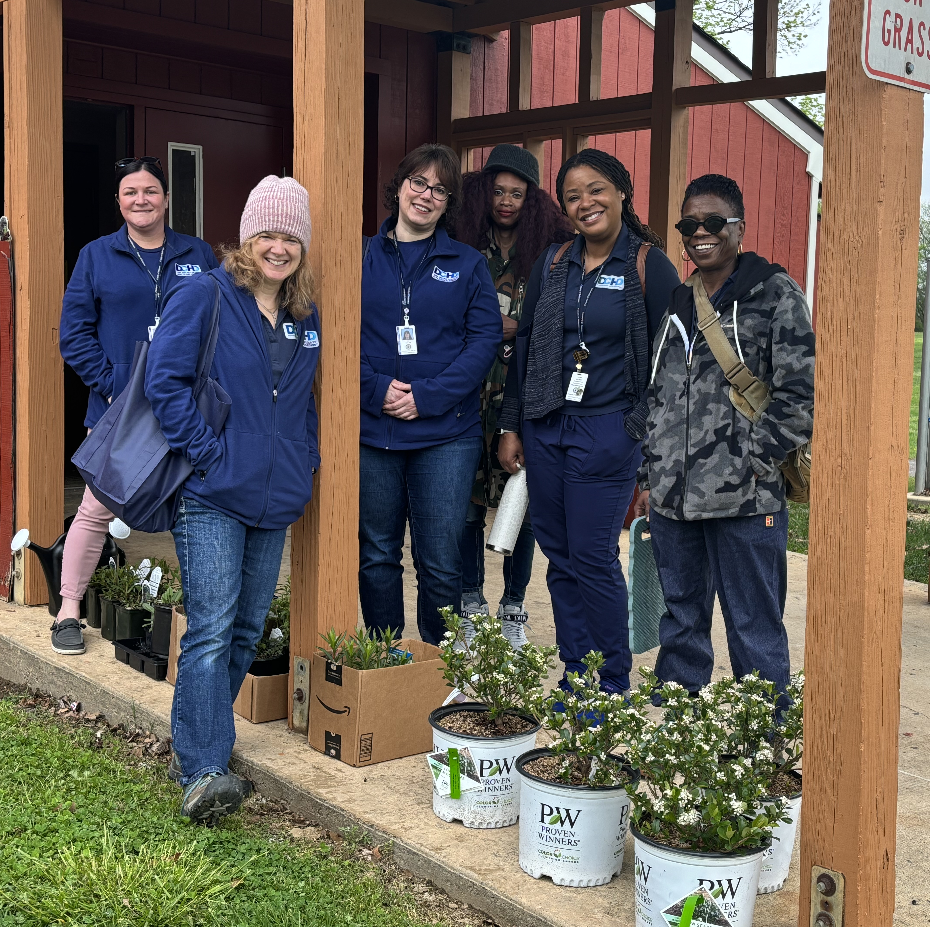
Table of Contents
Social Media
Analytics
Top Performing Posts
Earned Media
News Media Stories
Press Conferences
Paid Media
Test and Go, Delco Revive
Video
CHIP Explainer, STI Myths, Narcan Tutorial.
Video Production
Test and Go Launch
2024 DCHD Recap

Slide 3
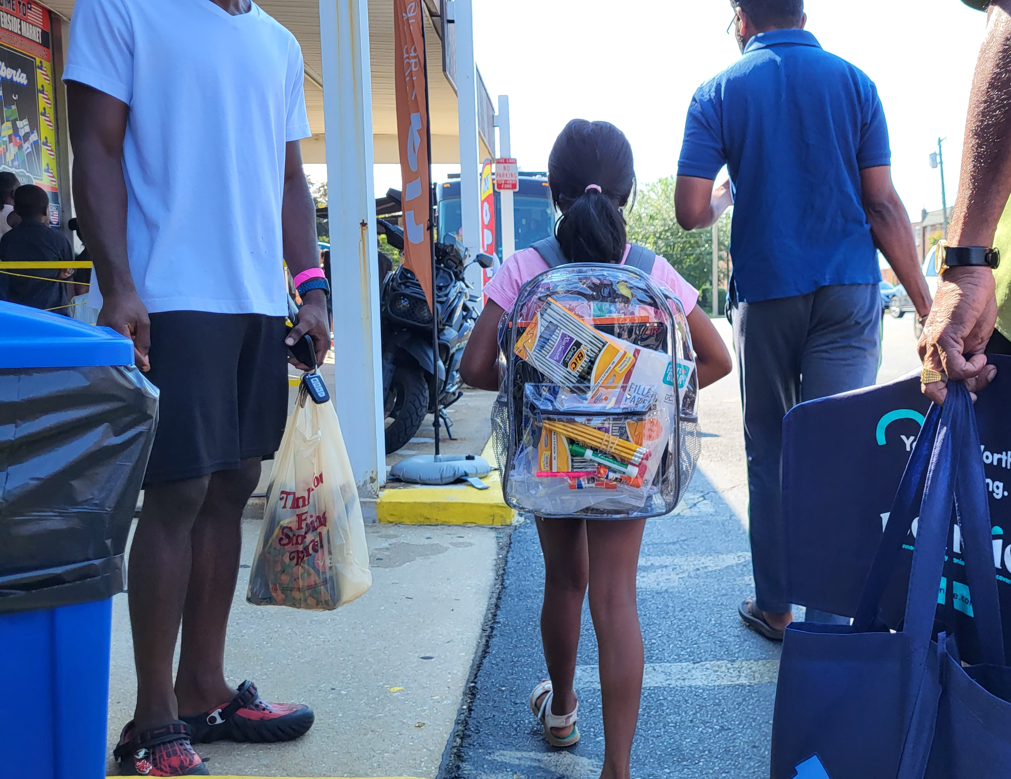
Social Media The Delaware County Health Department Maintains 3 individual Social Media Accounts -DCHD has access to the County YouTube and LinkedIn Channels
Facebook - @DelcoHealth
Dec. 2024 Dec. 2023
Followers 1.8k Followers 1.6k
Reached 622.7K Reach 96.2k
Instagram - @delcohealthdepartment
Followers
Dec. 2024 – 765 Dec. 2023 - 600
Impressions
Dec. 2024 – 22.7k Dec. 2023 - 19.6k
X X
X(Twitter) - @DelcoHD
Dec. 2024 180 Followers

Slide 4
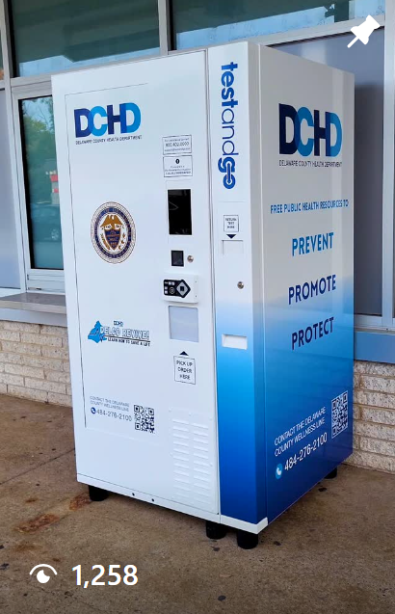
Top Performing Social Media Posts
DCHD Test and Go Reel
Black History Month Public Health Pioneer
Instagram
1258 Views
733 Reached
50 interactions
Facebook
3k Reached
3.3k Impressions
150 Interactions
Instagram
458 impressions
389 Reached
458 interactions

Slide 5
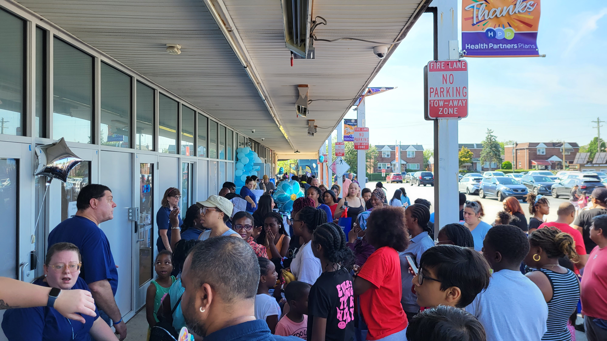
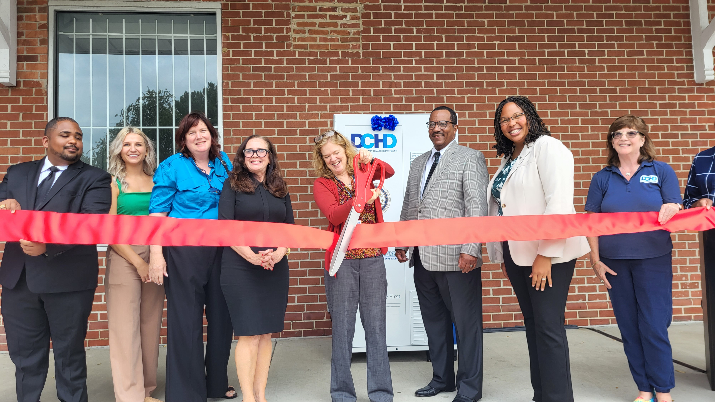
Earned Media -Earned Media is referred to as no cost local or national news coverage.
Top Stories
Test and Go Kiosks Installed
Back To School Backpack Giveaway
Delco Revive – Learn to Save a Life
Clean the Green DCHD Delivers
Jefferson Mammogram Screening Events
Strollin’ Colon Cancer Awareness
Whooping Cough

Slide 6
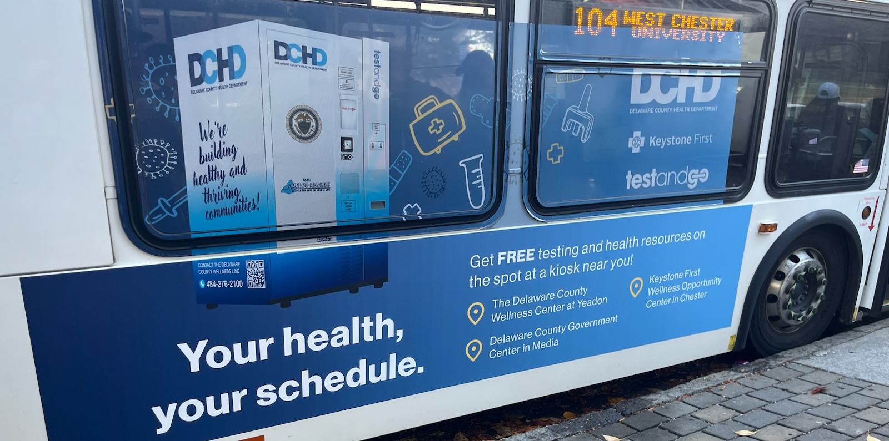
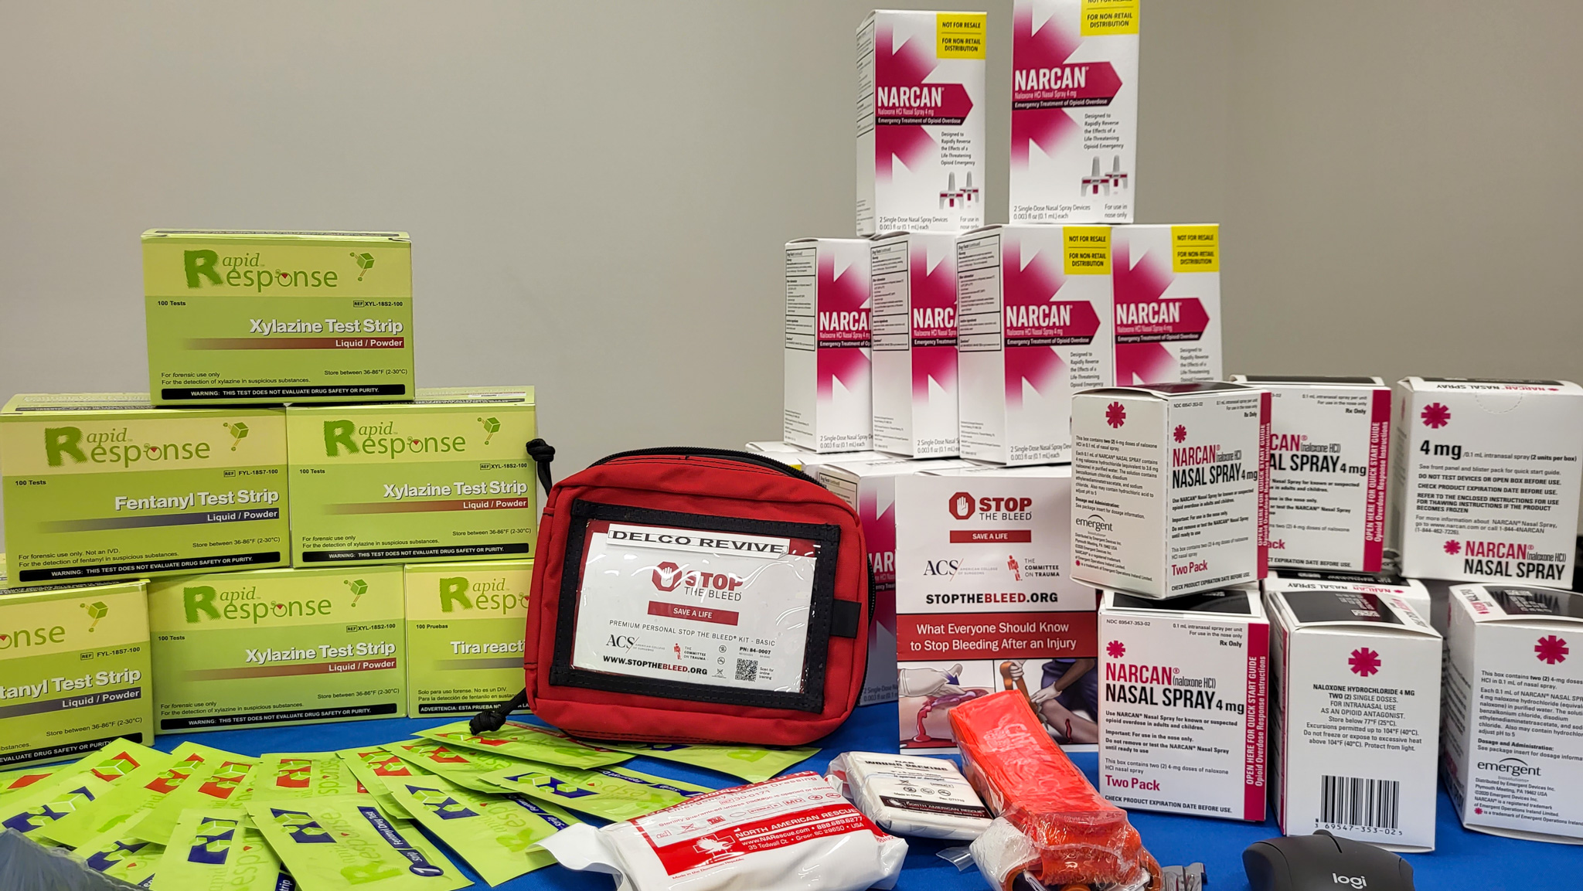
Paid Media
Elemeno Productions:
STI Facts Verse Myths
Delco Revive Narcan
CHIP Explainer ((https://www.youtube.com/watch?v=1YWAyAZStbI&feature=youtu.be)
Delco Revive
KYW News Radio
Paid Social
Promotional Material
Test And Go
Septa Bus Exteriors/Interior/Digital Platforms
Clear Channel Bus Shelters
Paid Social

Slide 7
Test and Go
https://youtube.com/shorts/Iu3k0ISIHiU

Slide 8
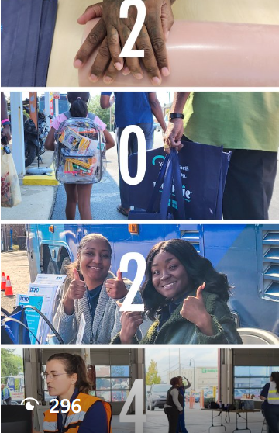
2024 Recap
https://youtube.com/shorts/DEn8HXZdLSk

