Slide 1
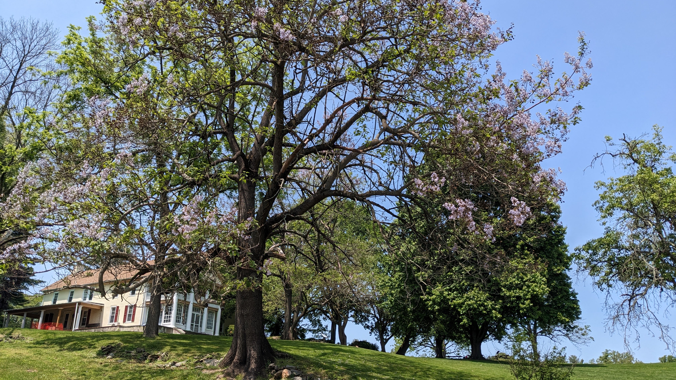
Delaware County Parks & Recreation
Rose Tree Park Media, Pa

Slide 2
Rose Tree county Park
118 Acres in Upper Providence Township
Fairgrounds
Outdoor amphitheater and concert stage
Wooded trail
Meadow (in development)
3 Memorials (Delco. Law Enforcement Foundation, Philip Jaisohn Foundation)
3 Historic buildings housing County offices Leedom House: Parks & Recreation Dept. Hunt Club: Conservation District, PRC Rose Tree Tavern: VisitDelco

Slide 3
Amenities & Facilities
2nd Largest Cross-Country Course in PA
Destination Playground with Pavilion
118 Community Garden Plots
Rose Tree Summer Festival Concert Series
Picnic Tables
Gazebo
18-page StoryWalk, curated by the Delco Libraries system
2 Restroom Buildings (seasonal)
Tree-Lined Pedestrian Mall with Benches

Slide 5
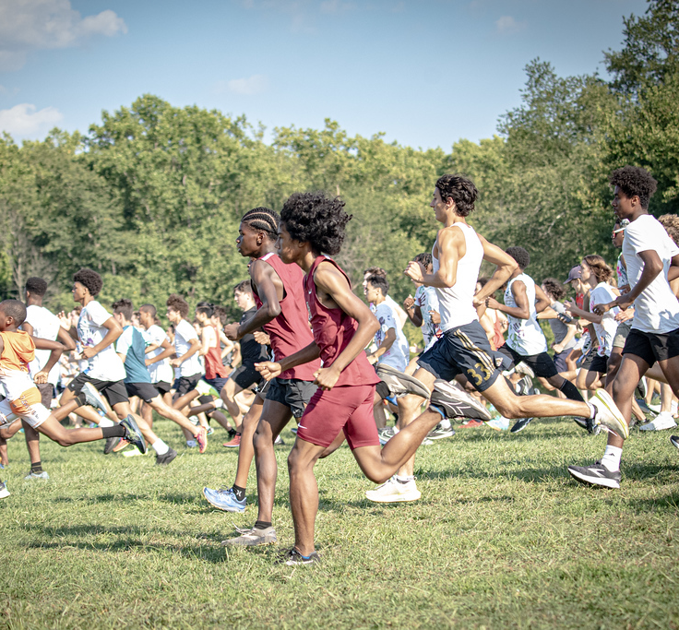
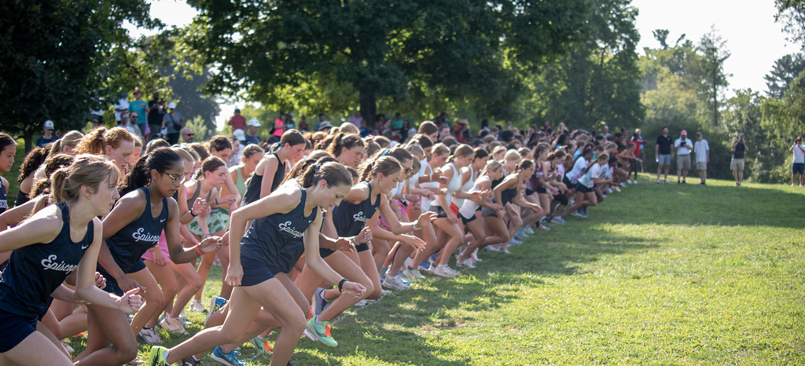
Cross Country Meets
Thousands of athletes from local middle schools, high schools, and colleges train and compete on the grounds.
Photo Credits:
Ryan Comstock Photography
Ryan Comstock
Ryan Comstock
Ryan Comstock

Slide 6
PROGRAMMING OVERVIEW
Engaging 100,000+ annually

Slide 7
ROSE TREE SUMMER FESTIVAL
DELCO’S ANNUAL CONCERT SERIES BELOVED TRADITION SINCE 1975
ADMISSION FREE

Slide 8
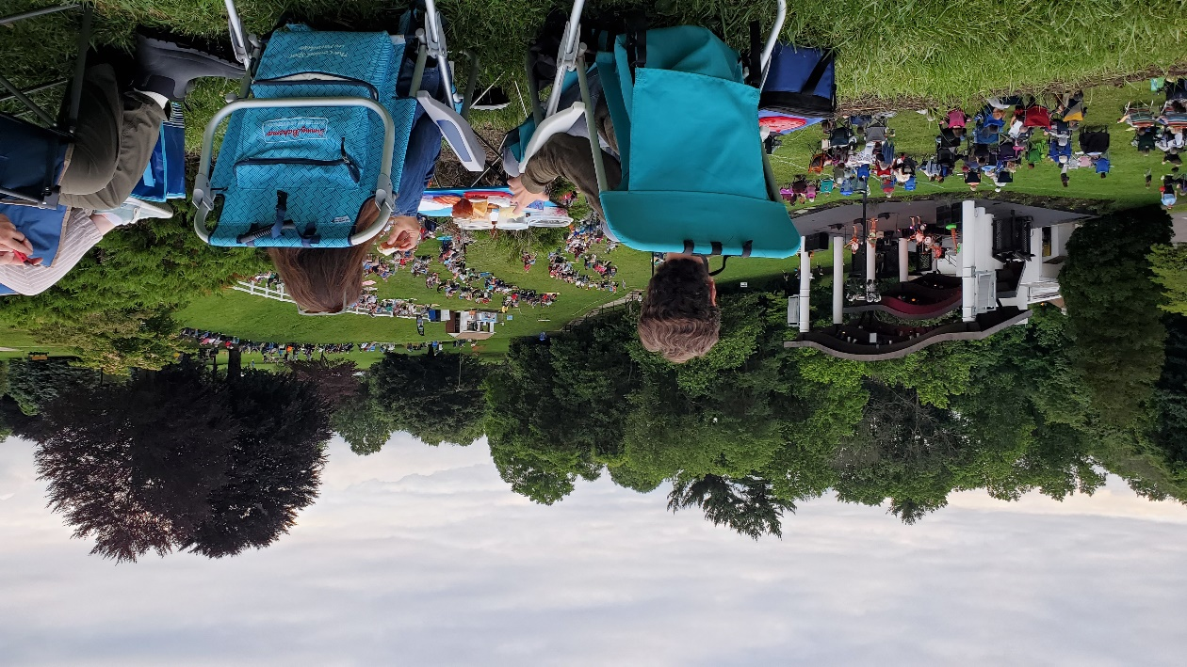
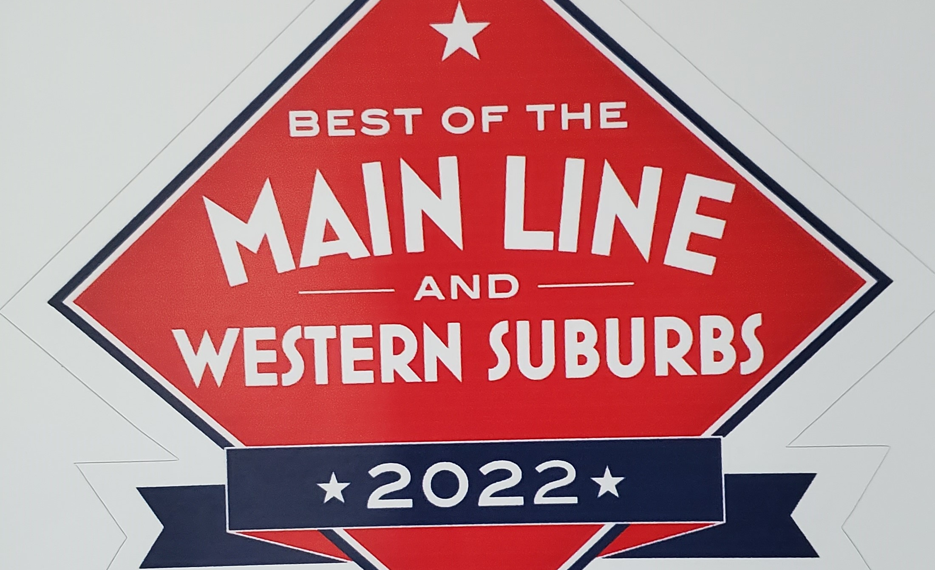
THE NUMBERS
9 WEEKS OF SHOWS
45 CONCERTS
800+ LOCAL PERFORMERS
35,000+ ATTENDANCE
THE SCENE
CHILDREN’S SHOWS
ROCK, POP, R&B
MOTOWN & DISCO
CLASSICAL MUSIC
BLUES, JAZZ & SWING
BROADWAY, OPERA
ZYDECO, MARDIS GRAS
BLUEGRASS & MORE

Slide 9
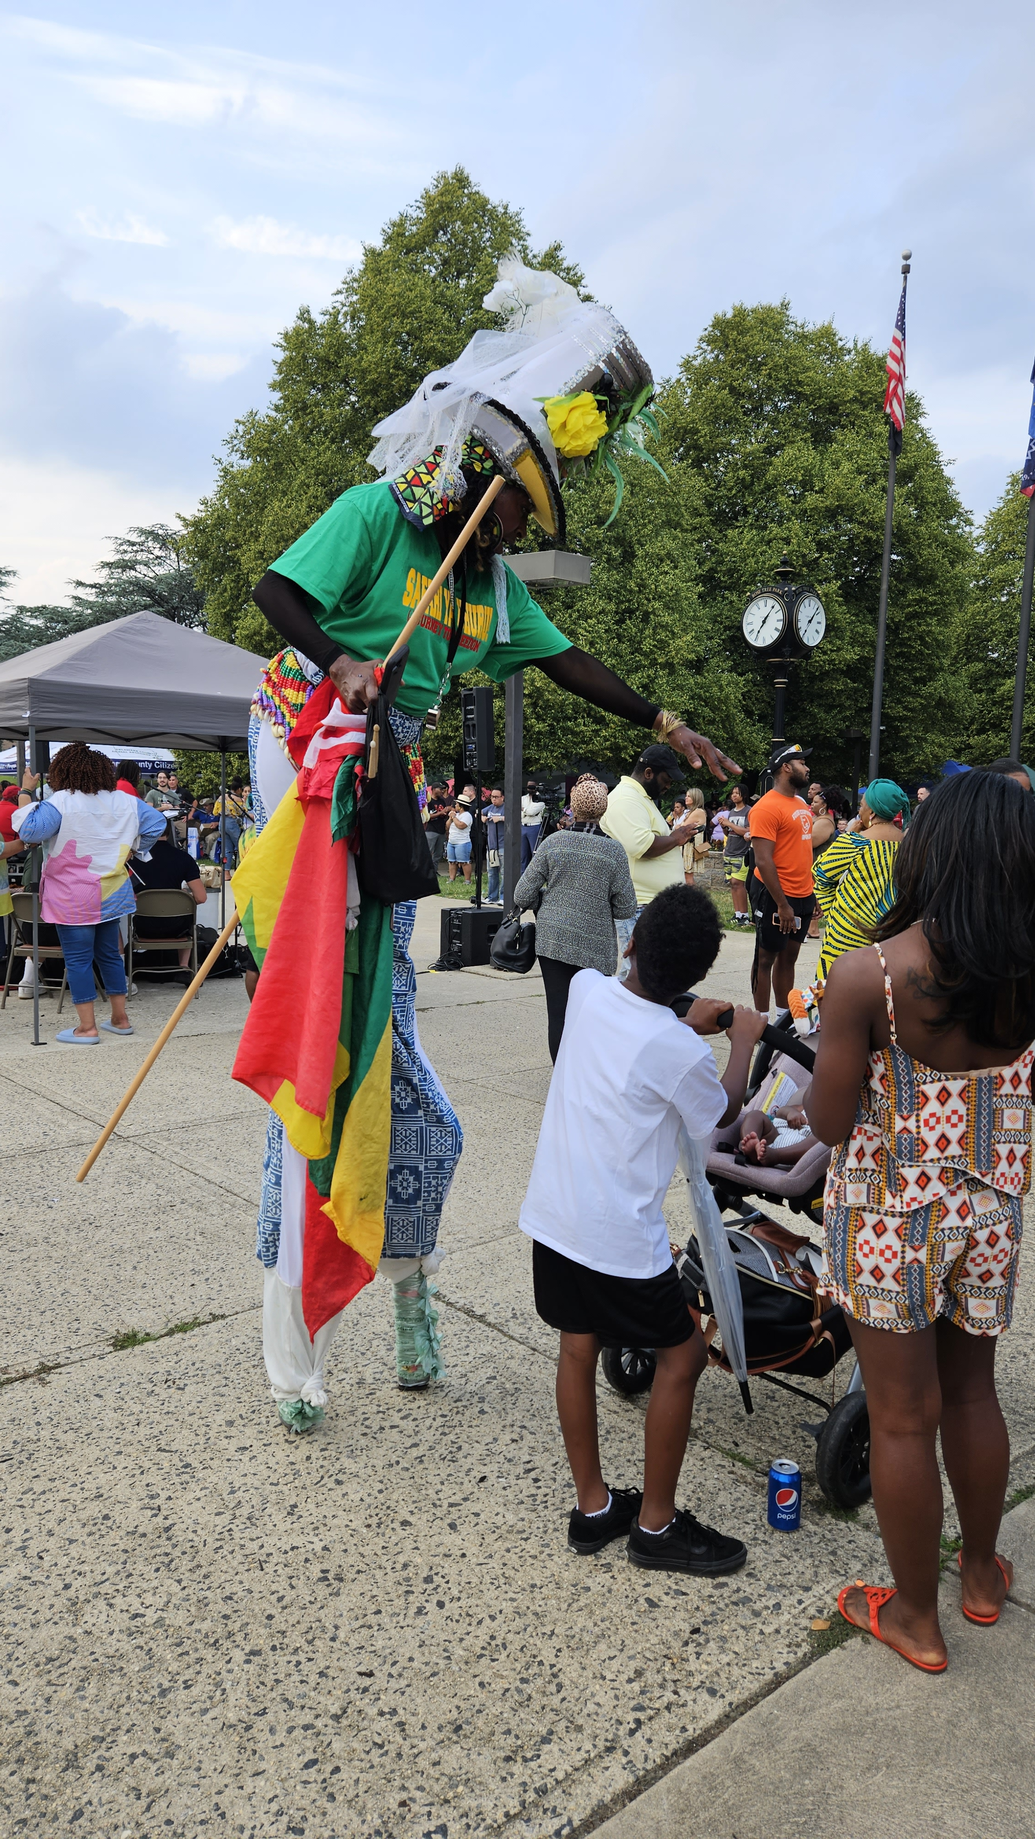
Delaware County's Juneteenth Celebration Performances, vendors, and a concert in Rose Tree Park

Slide 10
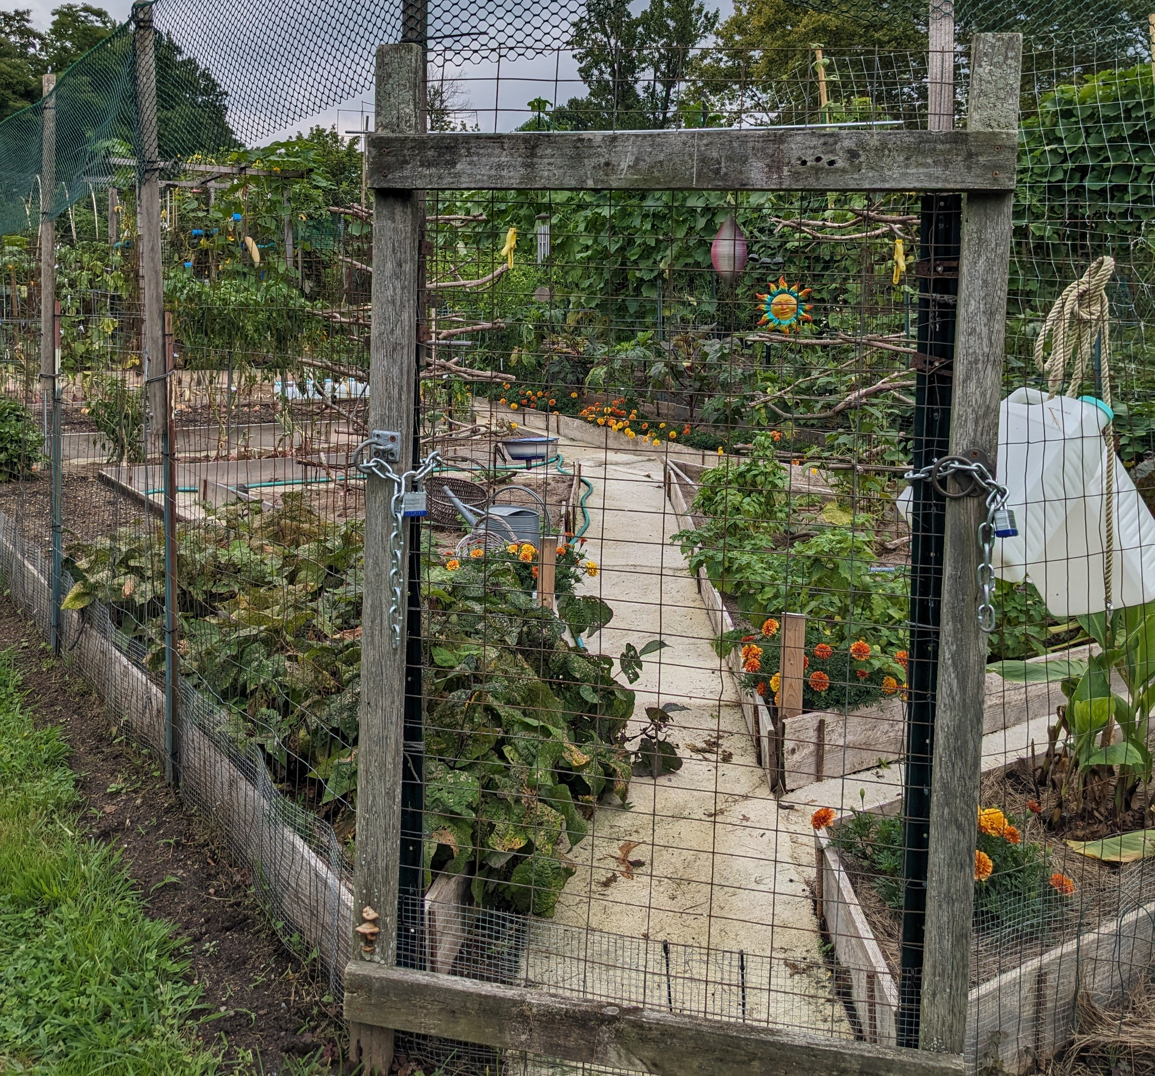
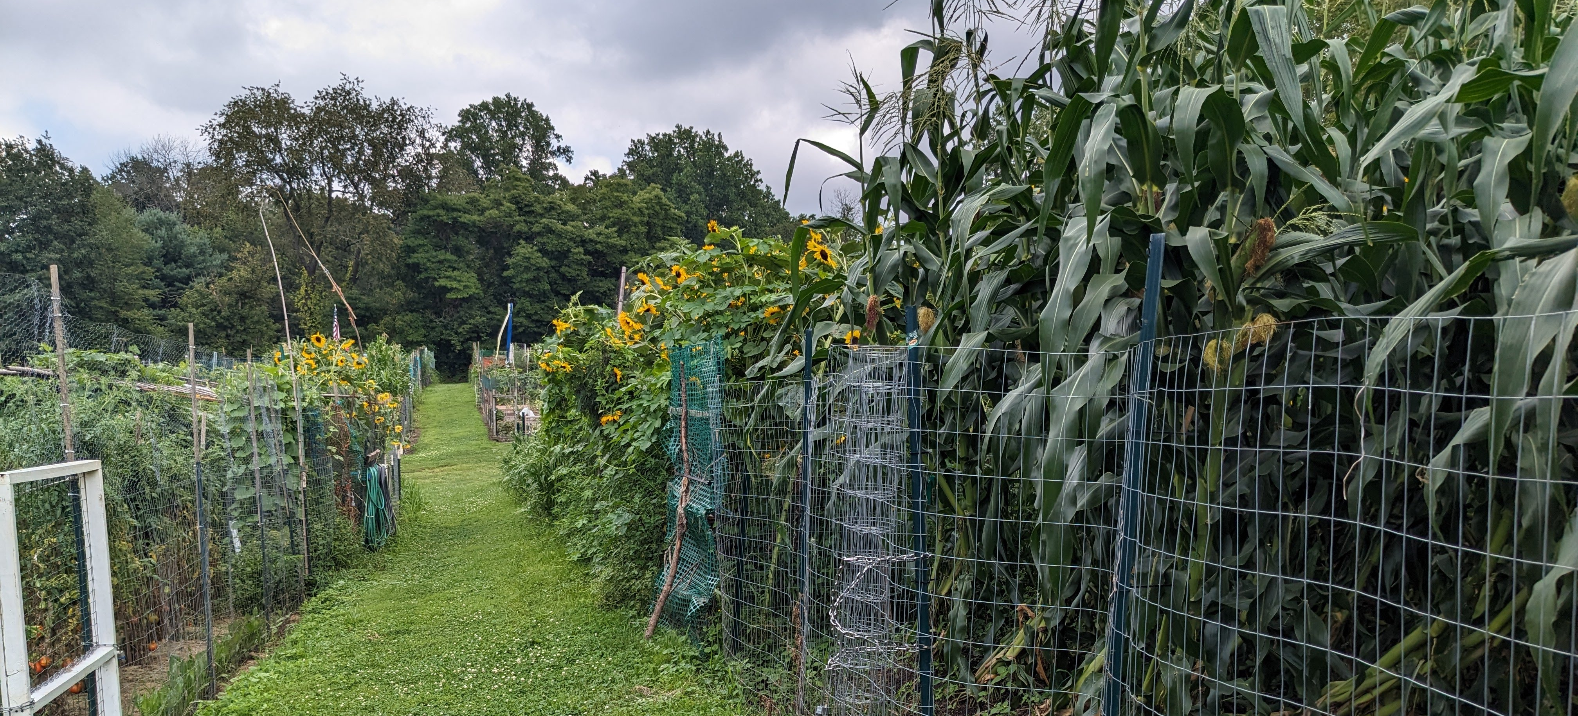
ROSE TREE COMMUNITY GARDENS
118 Farm Plots for seasonal lease
Season runs April – November
Gardeners pay a nominal fee and provide their own fencing, supplies.
Size: 20’ x 25’ Water source available
Non-commercial use only
Organic, non-toxic practices required
Popular for over 4 decades; there’s always waiting list.

Slide 11
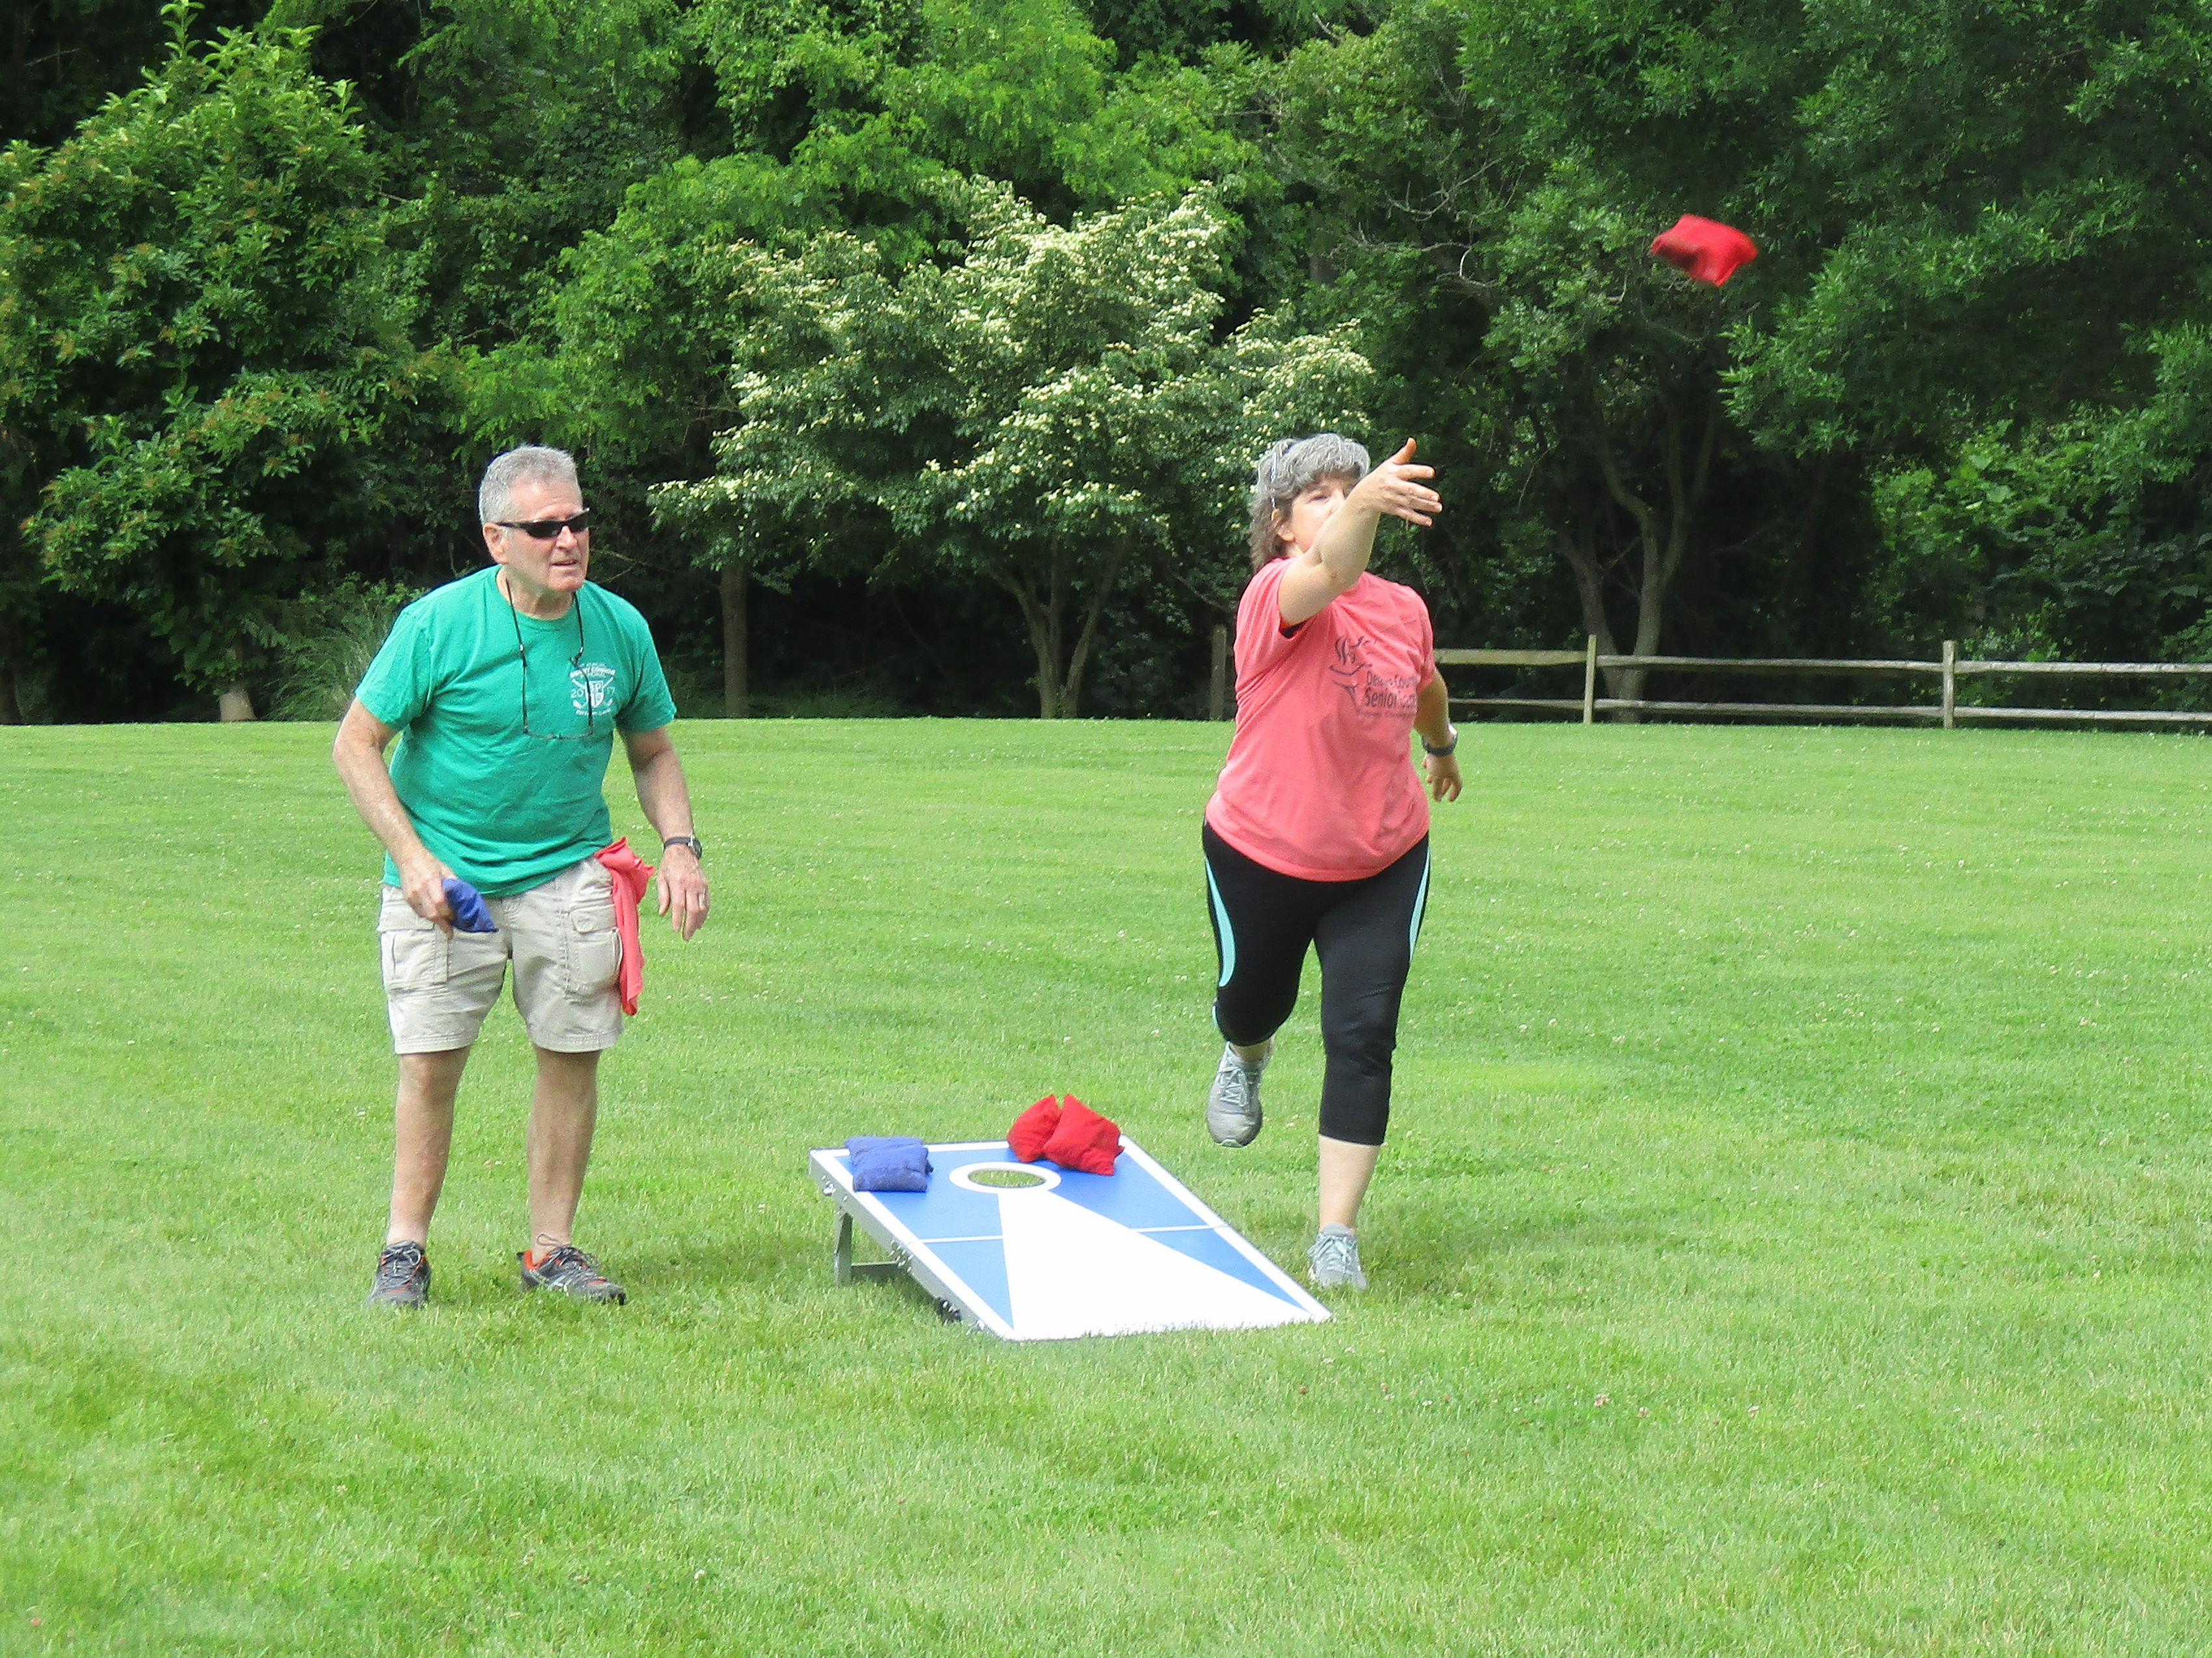
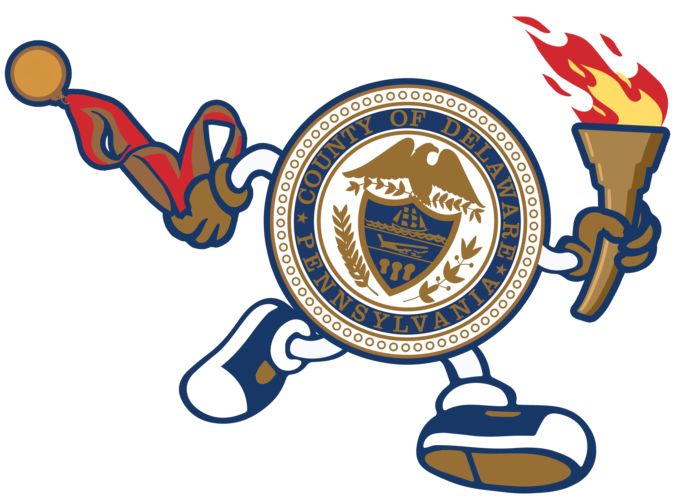
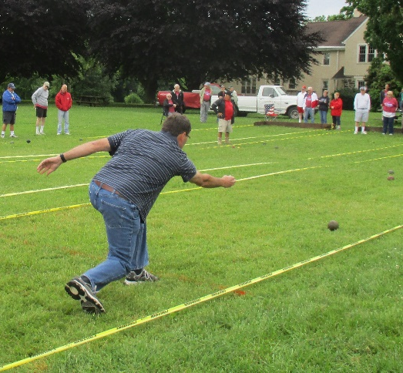
Delaware County Senior Games
Rose Tree Park Hosts Bocce & Corn Hole
DelcoSeniorGames.org
Mission: To engage residents age 50+ in two weeks of fun events that promote a healthy, social, and active lifestyle.

Slide 12
Displays are lit nightly throughout December, free for public enjoyment and enjoyed by tens of thousands of residents.
The Festival of Lights A Delco Tradition Since 1976

Slide 13
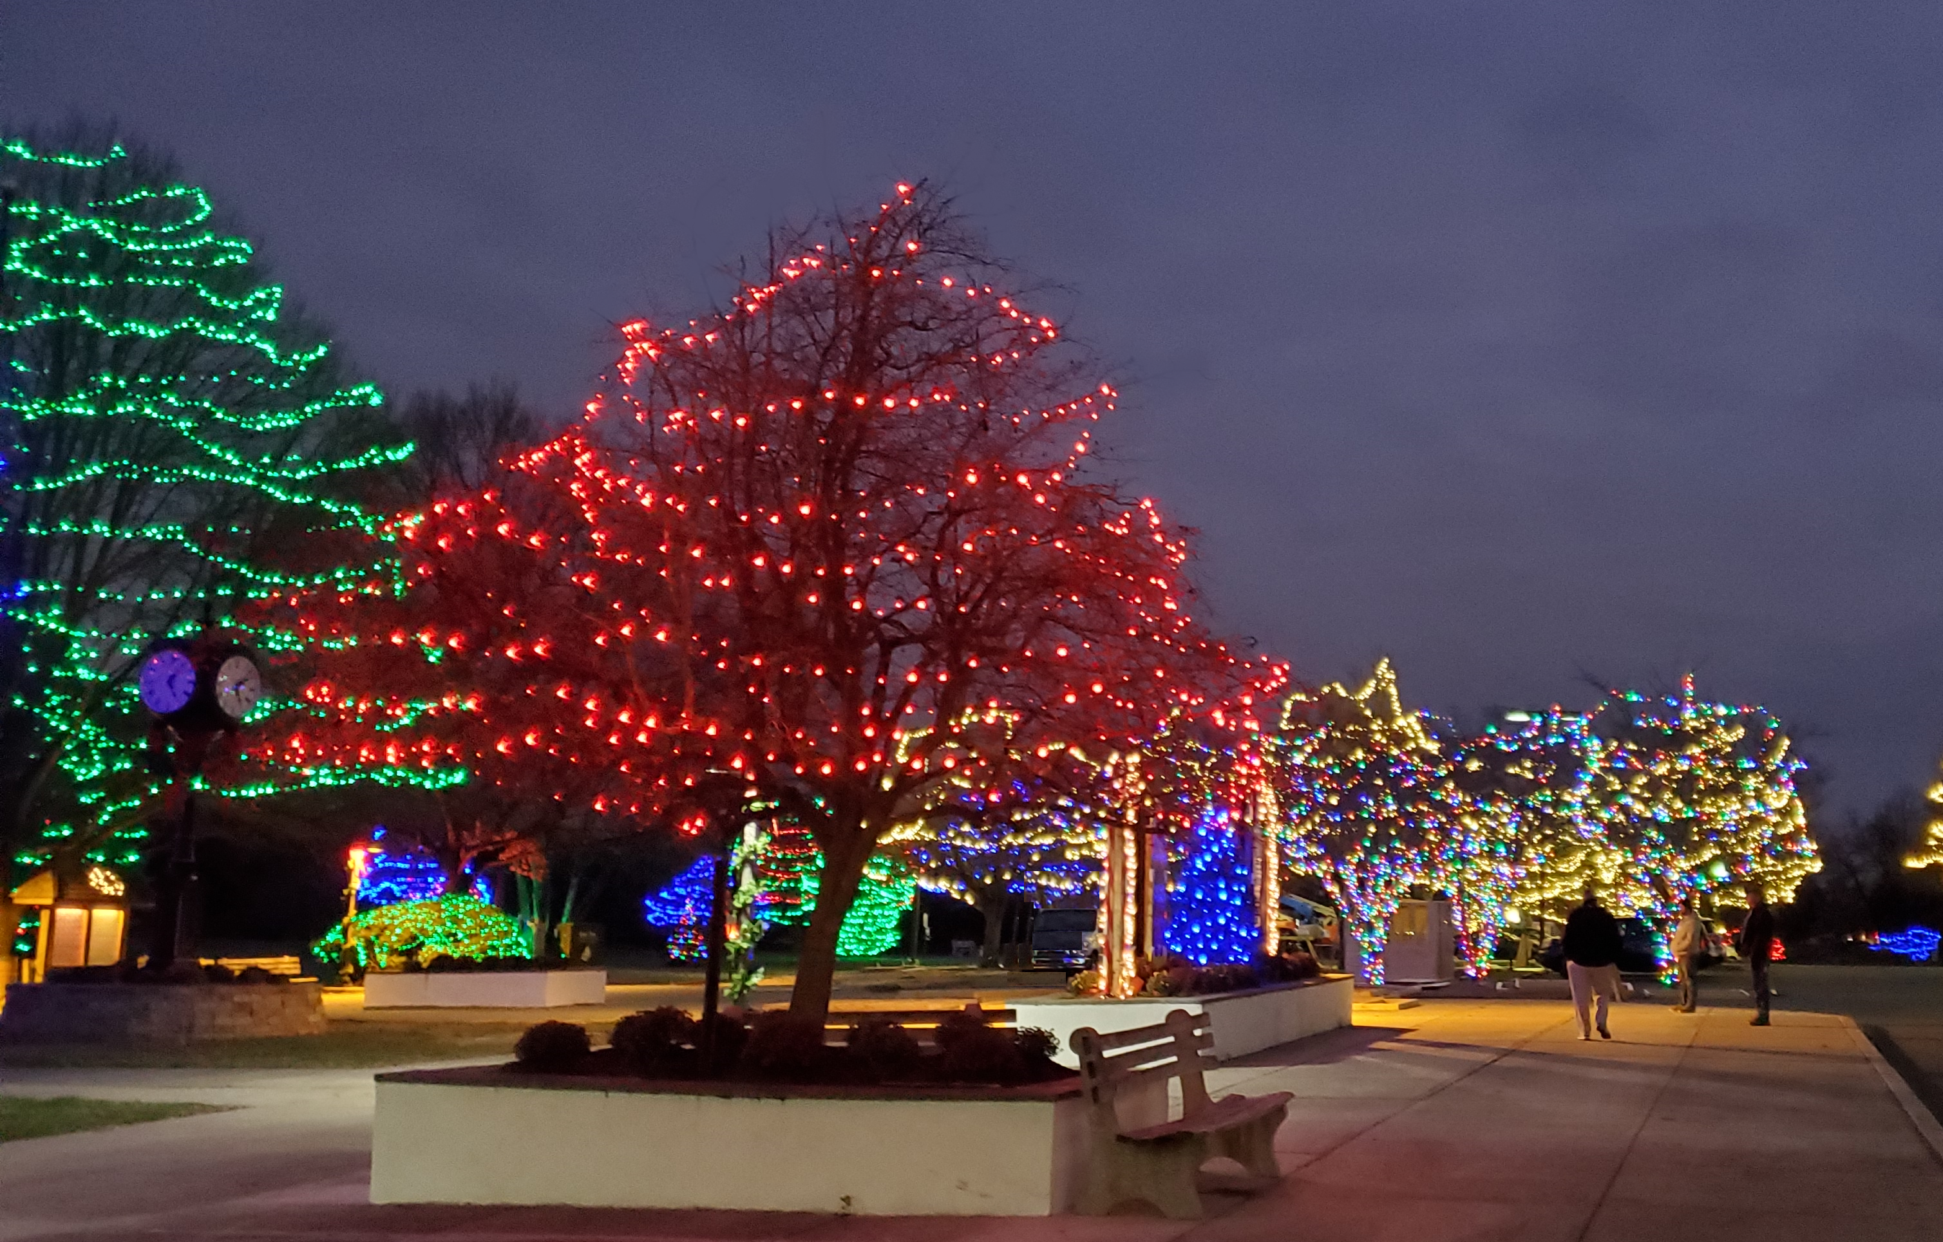
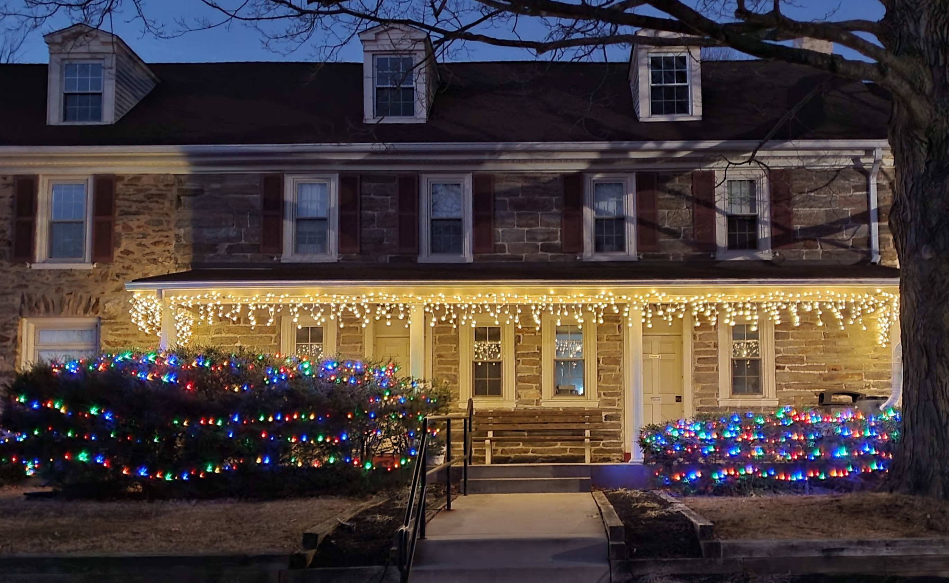
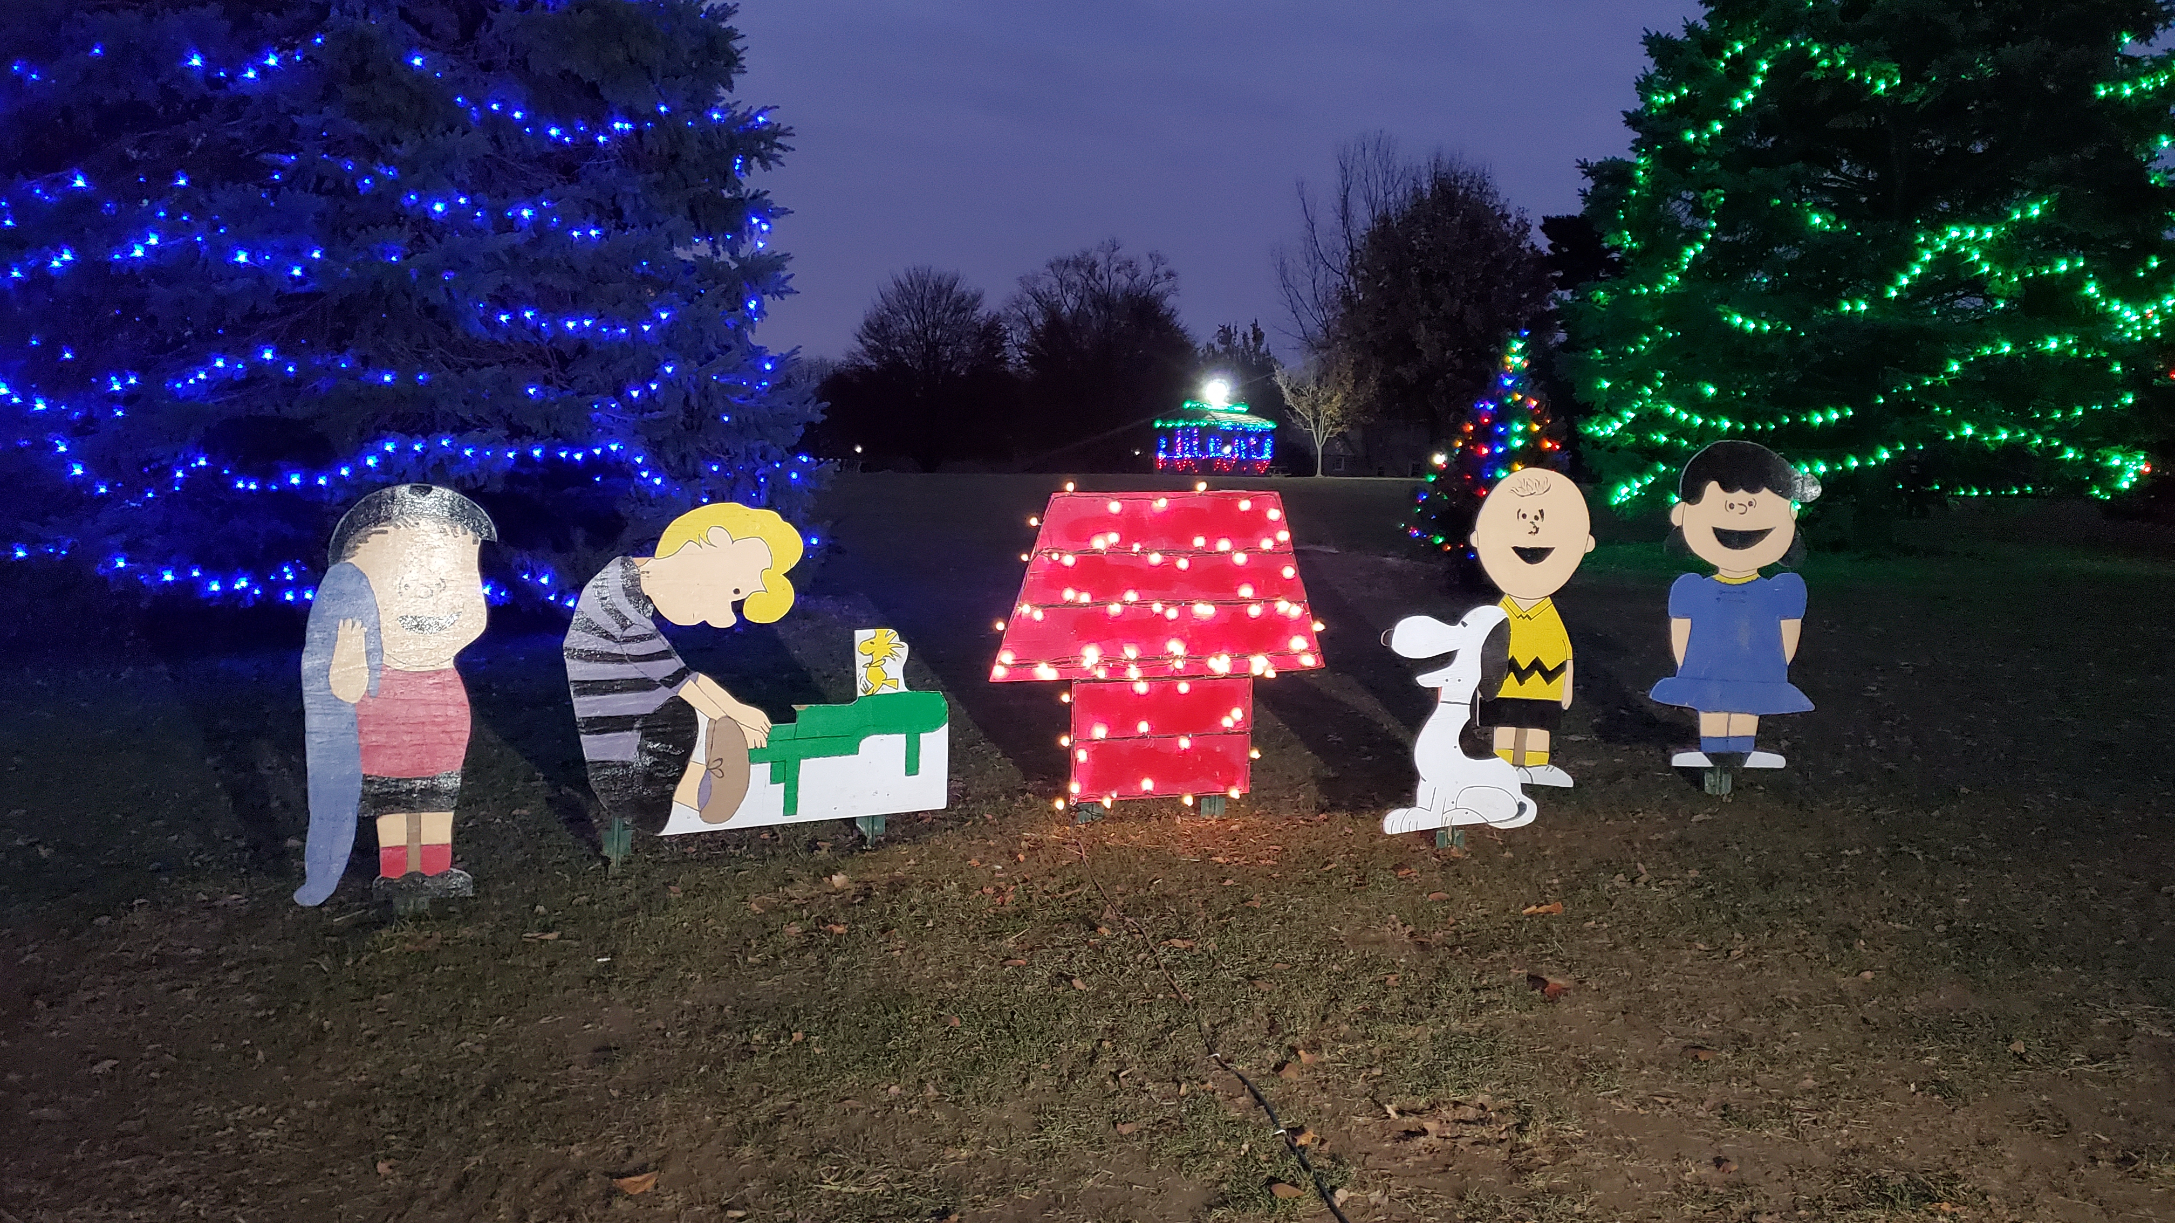
The Festival of Lights is a walk-through display.
Admission and parking are free.
Friendly, leashed dogs are permitted.
Historic Hunt Club Building

Slide 14
Historic Rose Tree Tavern
Produced by The Delaware County Parks & Recreation Department, 2024.
Audio Credit: Sweet Dreams by BatchBug | https://soundcloud.com/batchbug/
Music promoted by https://www.chosic.com/free-music/all/
Creative Commons Attribution 3.0 Unported License https://creativecommons.org/licenses/by/3.0/deed.en_US

